Slide 1
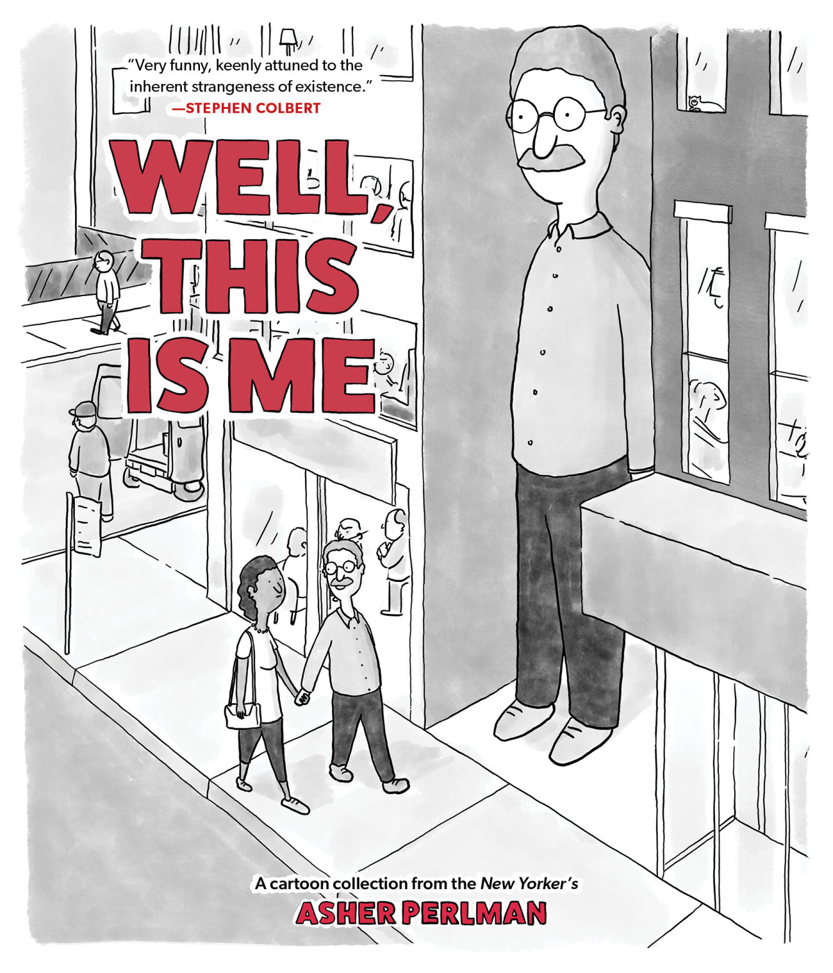
Writing For Impact
Guiding Students Toward Publication and Presentation
FALL 2026
Session 4: Pedagogy

Slide 2
Tendencies across fields
Field | Faculty–student co-authorship | Why
Medicine, life sciences, chemistry, physics | Very common | Research is laboratory-based, grant-funded, and highly collaborative
Engineering and computer science | Common | Projects involve teams, software, experiments, and technical development
Psychology and education | Moderately to highly common | Faculty often conduct research with graduate or undergraduate assistants
Social sciences | Variable | More common in quantitative and large-scale empirical research
Humanities and literary studies | Less common | Scholarship is traditionally based on individually authored works
STEMM: graduate student is the lead writer; faculty member contributes as/or editor, mentor, supervisor (Bozeman and Youtie, 2017)
LITERARY STUDIES: “most entrenched model of authorship” as the sole author (Leane, Fletcher and Garg, 2019)
While the sciences assume collaboration, and have complicated protocols for adjudicating it, the humanities, despite their gravitational pull toward the monograph whose etymological roots lie in scientific discourse (‘a single treatise on a separate species or genus’, according to the OED), often look askance at collaboration especially as manifest in written work (Battershill et al. 2017)

Slide 3
Pedagogies
Form//Pedagogical Strategy | Students as researchers | Students as writers
Research apprenticeship | Collab with faculty and students on an existing research project | Contribute to reports, conference papers, articles, or book chapters -> Publish and/or present
Inquiry//-based learning Participatory or community-based research | Question ->data gathering (collabs) -> interpretation | Contribute to//produce reports, papers, articles ->Publish and/or present
Course-based undergraduate research (CURE) Project-based learning | Conduct original research as part of a course rather than joining an individual faculty lab (faculty mentors) Design and complete a sustained research or creative project (faculty mentors) | Produce research papers, posters, presentations, or journal-style reports -> Publish and/or present
Process-based writing | Treat research and writing as iterative activities involving revision and feedback (faculty mentors) | Move through proposal, literature review, draft, peer review, revision, and final submission
Writing-to-learn Writing in the disciplines programs | Use informal writing to formulate questions, record observations, and reflect on evidence Learn how research is conducted and communicated within a particular field | Practice disciplinary genres such as lab reports, literature reviews, policy briefs, or archival essays Develop ideas through journals, research memos, freewriting, and reflective notes

Slide 4
mentoring
Mentor roles –
career support such as sponsorship, coaching, providing challenging work; and
psychosocial support such as role modeling, counseling, friendship, acceptance (Thiry & Laursen, 2011).
Recommendations from the National Academies of Sciences, Engineering, and Medicine (2019):
Establish and use structured feedback at all levels (including feedback from your students)
Support multiple mentorship structures
Mitigate problems; have a network of faculty to share, and when necessary, seek help
Institutions and programs should adopt an evidence-based, operational definition of mentorship (including time allotment expected and/or recommended)

Slide 5
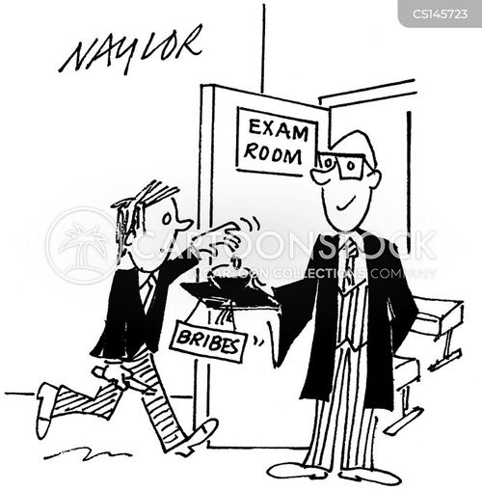
Best practices
establish clear expectations and goals;
provide appropriate structure and supervision;
teach research methods explicitly;
encourage students to take intellectual ownership;
foster independence
give frequent and constructive feedback;
support students’ professional development;
reflect on and evaluating the mentoring relationship.
use emerging technologies;
Notes:
Note - Mentor support - novice student - clear expectations, guidelines, and orientation to their specific research project, experienced student - socialization into the field (adopting the traits, habits, and temperament of scientific researchers Thiry & Laursen, 2011).

Slide 6
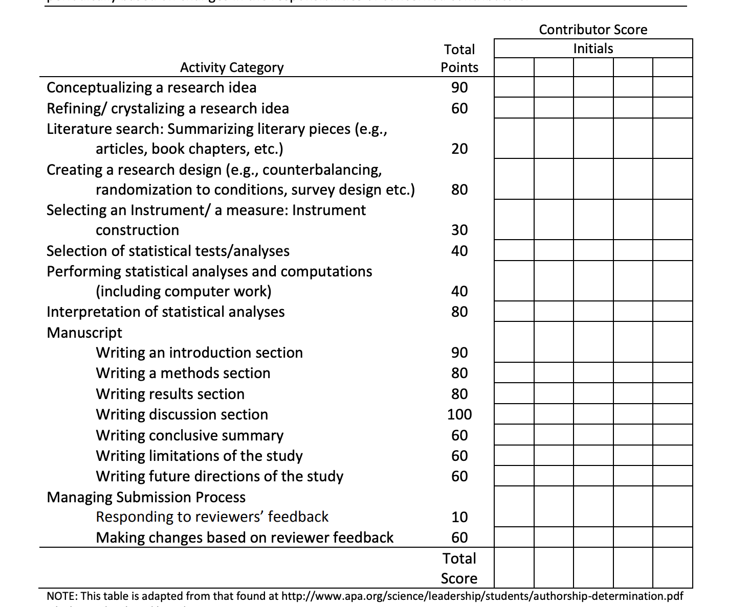
So.. What do I do?
Authorship - entails a public acknowledgment of scientific or professional contribution to a disseminated piece of information (see APA, 2002) and includes involvement in various tasks associated with the project (National Health and Medical Research council, 1997).
The guidelines offer general conceptualizations (vs. concrete unambiguous definitions); collaborators must further discuss and reach consensus on (a) what constitutes a scientific contribution; (b) how authorship order is decided upon, and (c) how to engage in the process of authorship determination (APA Science Student Council)*
Notes:
https://psychology.nd.edu/assets/198758/ContractWorksheet.pdf
** Worksheet - https://www.siue.edu/graduate/pdf/authorship-determination-scorecard.pdf

Slide 7


AI use
US Copyright law*: Requieres human authorship codified in the Constitution & in interpretations by the courts.
“[T]he author [of a copyrighted work] is . . . the person who translates an idea into a fixed, tangible expression entitled to copyright protection.” (Supreme Court).
Non-copyrightable: (a) text “authored by non-human spiritual beings” (b) photographs that a monkey captured with a camera; (c ) works created by the “new forms of technology operating absent any guiding human hand” – (e.i. “software product or service ”)
ICMJE:**:
Journals: must require to disclose whether they used artificial intelligence (AI)
Authors: should describe, in both the cover letter and the submitted work in the appropriate section if applicable, how they used it:
  AI was used for writing assistance, describe this in the acknowledgment section (see Section II.A.3);
  AI was used for data collection, analysis, or figure generation, describe this use in the methods (see Section IV.A.3.d);
  Chatbots (such as ChatGPT) should not be listed as authors because they cannot be responsible for the accuracy, integrity, and originality of the work, and these responsibilities are required for authorship (see Section II.A.1)
Notes:
* https://www.copyright.gov/ai/Copyright-and-Artificial-Intelligence-Part-2-Copyrightability-Report.pdf?utm_source=chatgpt.com
** *https://www.icmje.org/recommendations/browse/roles-and-responsibilities/defining-the-role-of-authors-and-contributors.html

Slide 8


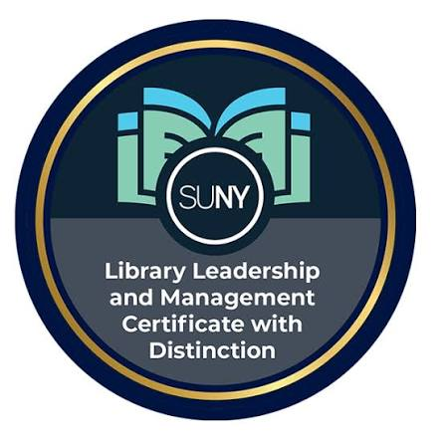

Policies:
ALA CORE policy*:
This policy limits the use of Generative AI tools by authors and prohibits use of Generative AI tools by peer reviewers for work under consideration by Core’s journals. The limitation on the use of AI tools to author articles is not meant to restrict research into potential uses of LLMs and/or Gen AI tools in libraries.
Authors: The use of is not allowed. In cases where such tools are used to support a human author’s writing or research, those uses MUST be acknowledged explicitly in the manuscript, including the specific tool(s) used, the prompts given, and the section(s) of the article that were enhanced in this manner.
Reviewers: The use of is not allowed. By using such tools, reviewers risk breaching confidentiality and giving away the author’s unpublished work to AI models.
Notes:
* https://www.ala.org/sites/default/files/2025-03/Core%20Publications%20-%20Generative%20AI%20Policy%2006.28.24.pdf?utm_source=chatgpt.com

Slide 9
resources
Battershill, C., Southworth, H., Staveley, A., Widner, M., Gordon, E., Wilson, N. (2017). Reflections on collaboration. In Scholarly Adventures in Digital Humanities: Making the Modernist Archives Publishing Project, (47–67). Cham: Springer. New doi:10.1007/978-3-319-47211-9_4.
Bozeman, B., & Youtie, J. (2017) The strength in numbers: The new science of team science. Princeton University Press. https://doi.org/10.1515/9781400888610
Leane, E., Fletcher, L., & Garg, S. (2019). Co-authorship trends in English literary studies, 1995–2015. Studies in Higher Education, 44(4), 786-798.
National Academies of Sciences, Engineering, and Medicine. (2019). The Science of Effective Mentorship in STEMM.
Thiry, H., & Laursen, S. L. (2011). The role of student-advisor interactions in apprenticing undergraduate researchers into a scientific community of practice. Journal of science education and technology, 20(6), 771-784.

