Slide 1
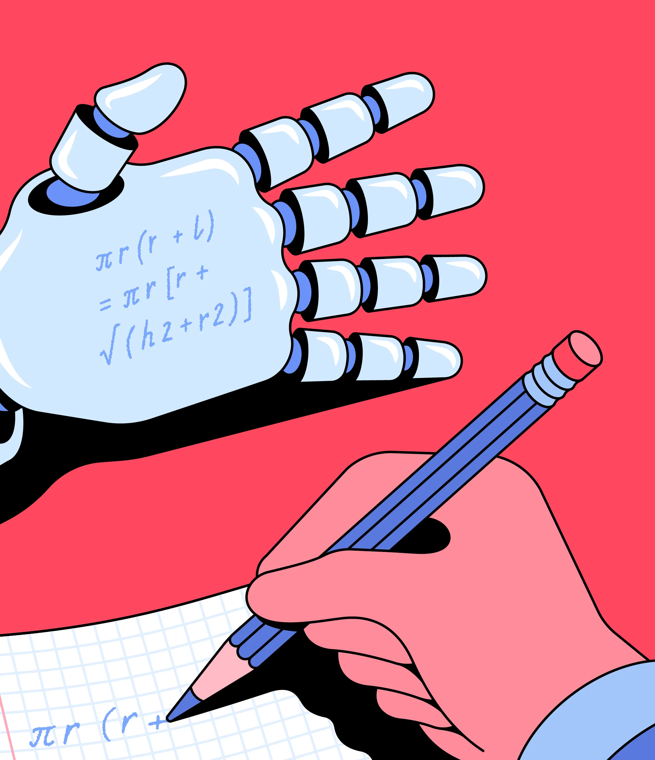
Writing For Impact
Guiding Students Toward Publication and Presentation
FALL 2026
Session 3: Authorship in the AI age

Slide 2


Who is author?
US Copyright law: The creator of the original expression in a work is its author. The author is also the owner of copyright unless there is a written agreement by which the author assigns the copyright to another person or entity, such as a publisher. In cases of works made for hire, the employer or commissioning party is considered to be the author.
- Authorship confers credit;
- Assigns (implies) accountability for published work;
- Has financial, social, scholarly implications.
ICMJE: Must meet four criteria**:
- Substantial contributions to the conception or design of the work; or the acquisition, analysis, or interpretation of data for the work; AND
- Drafting the work or reviewing it critically for important intellectual content; AND
- Final approval of the version to be published; AND
- Agreement to be accountable for all aspects of the work in ensuring that questions related to the accuracy or integrity of any part of the work are appropriately investigated and resolved.
Notes:
* https://www.copyright.gov/help/faq-definitions.html?utm_source=chatgpt.com
** *https://www.icmje.org/recommendations/browse/roles-and-responsibilities/defining-the-role-of-authors-and-contributors.html

Slide 3
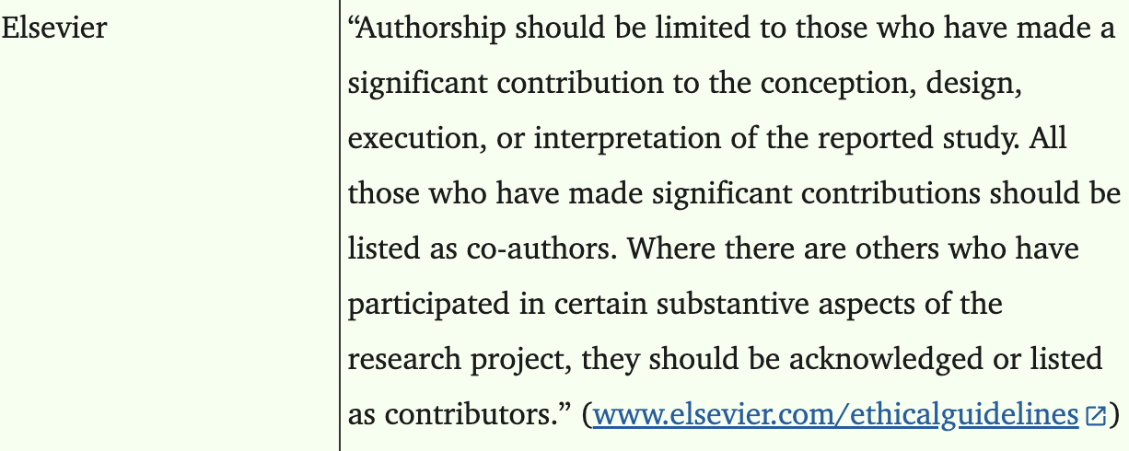
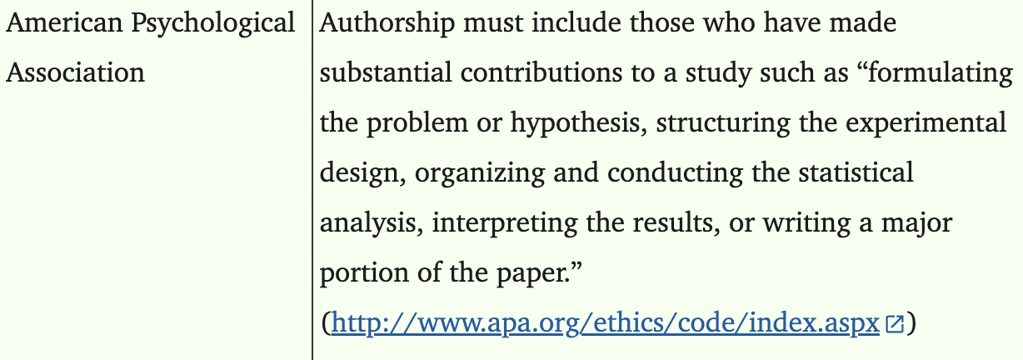
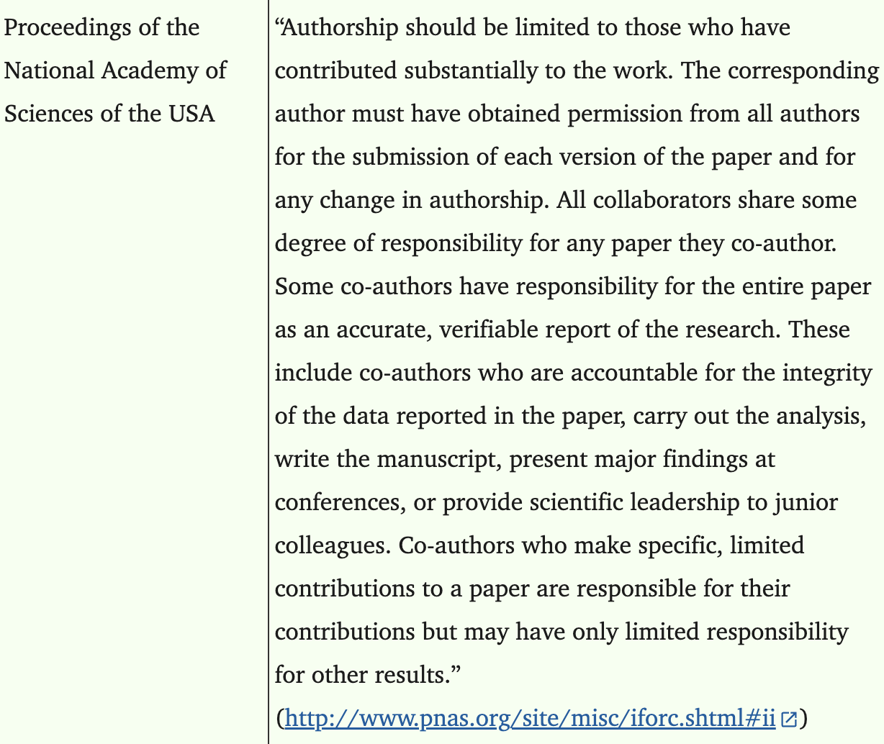
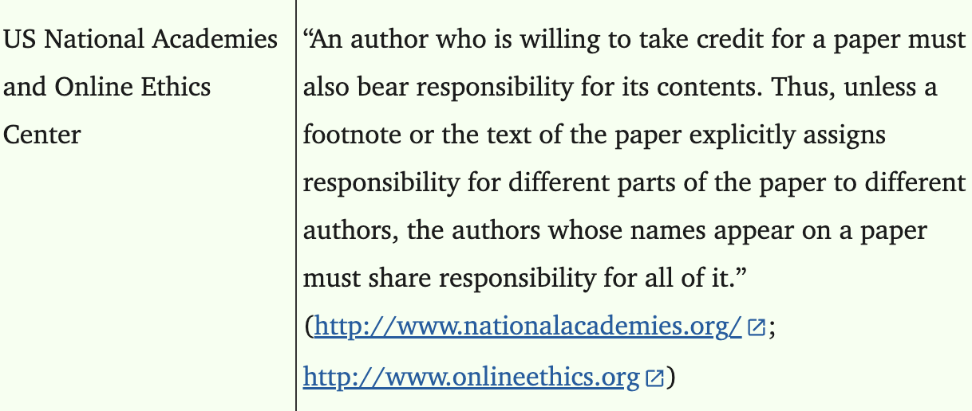
Other standards

Slide 4
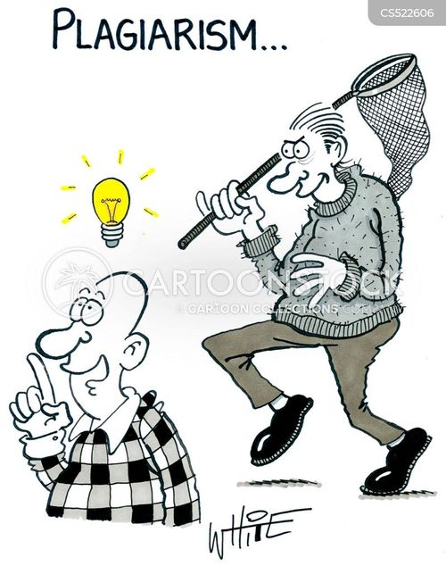
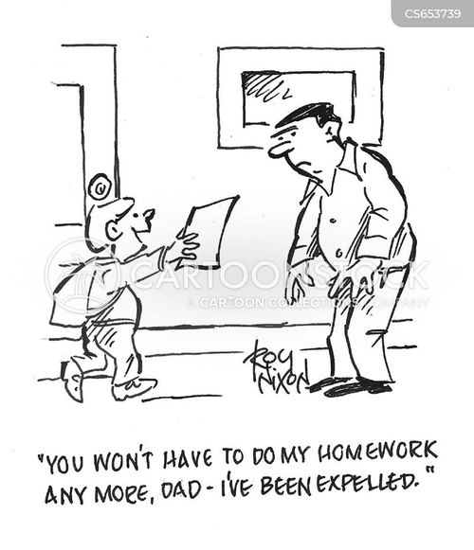
storytelling
Your experiences in assigning credits and/or being (or not) credited

Slide 5
What about collabs?
EMBO 2011 investigation*: Collaboration (persons or entities) is a recursive process that can fundamentally change the approach of the individual partners to achieving the goal [publishing their results in a peer-reviewed journal]
Partnership is a formal arrangement among entities and/or individuals to advance their interests.
Cooperation - a collab where the individual partners maintain their separate activities and interests, but join forces temporarily to meet a common goal
PROBLEM: rarely collabs authors (published ones) assume all 3 roles, as assigned by the ICMJE
PROBLEM 2: authors often sign licenses with publishers stating that they will abide by the publisher's guidelines, which often include observance of the ICMJE ethical standards. Authorship not in line with the ICMJE guidelines would therefore invalidate the license
Notes:
* The ethics of collaborative authorship (2011) by European Molecular Biology Organization (EMBO) https://pmc.ncbi.nlm.nih.gov/articles/PMC3166465/

Slide 6
NON-Authors
ICMJE Non-authors*: Contributors who meet fewer than all 4 of the above criteria for authorship are not authors, but should be acknowledged, specifically:
Funders;
Mentors of a research group, supervisors and supportive administration;
Writing assistants: editors in technical, language and proofreading areas.
How to acknowledge:
Individually or as a group under a single heading (e.g. "Participating Investigators")
Contributions should be specified (e.g. "served as scientific advisors," "reviewed proposal," "collected data," "provided and cared for study patients," "participated in writing or technical editing of the manuscript")
The corresponding author must obtain written permission to be acknowledged from all acknowledged individuals
Notes:
*https://www.icmje.org/recommendations/browse/roles-and-responsibilities/defining-the-role-of-authors-and-contributors.html

Slide 7
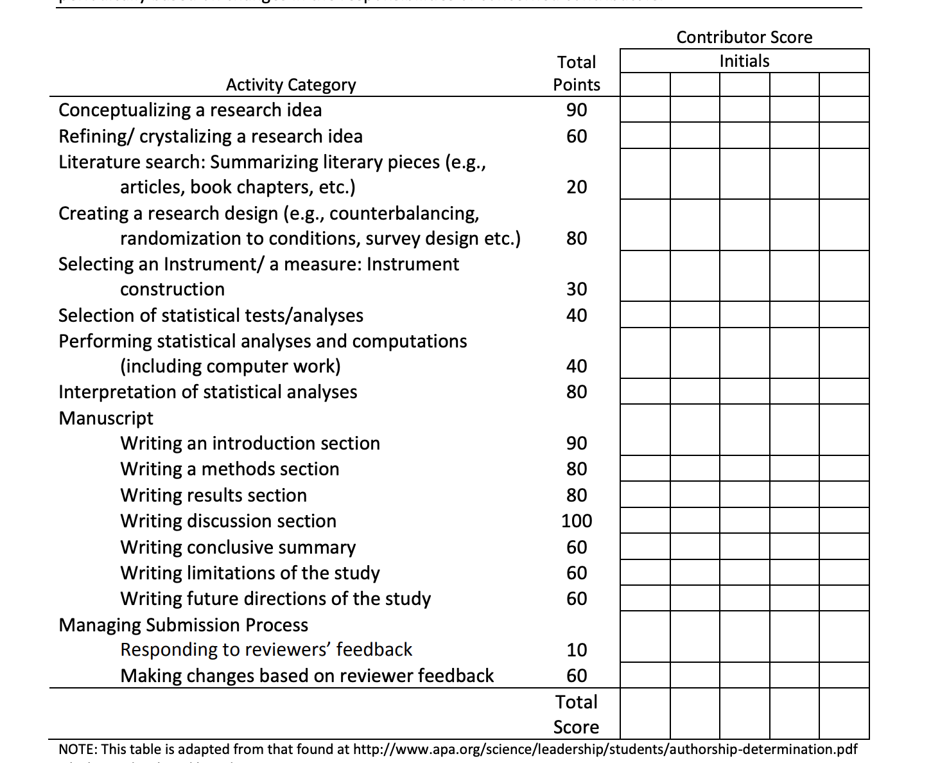
So.. What do I do?
Authorship - entails a public acknowledgment of scientific or professional contribution to a disseminated piece of information (see APA, 2002) and includes involvement in various tasks associated with the project (National Health and Medical Research council, 1997).
The guidelines offer general conceptualizations (vs. concrete unambiguous definitions); collaborators must further discuss and reach consensus on (a) what constitutes a scientific contribution; (b) how authorship order is decided upon, and (c) how to engage in the process of authorship determination (APA Science Student Council)*
Notes:
https://psychology.nd.edu/assets/198758/ContractWorksheet.pdf
** Worksheet - https://www.siue.edu/graduate/pdf/authorship-determination-scorecard.pdf

Slide 8
AI use
US Copyright law*: Requieres human authorship codified in the Constitution & in interpretations by the courts.
“[T]he author [of a copyrighted work] is . . . the person who translates an idea into a fixed, tangible expression entitled to copyright protection.” (Supreme Court).
Non-copyrightable: (a) text “authored by non-human spiritual beings” (b) photographs that a monkey captured with a camera; (c ) works created by the “new forms of technology operating absent any guiding human hand” – (e.i. “software product or service ”)
ICMJE:**:
Journals: must require to disclose whether they used artificial intelligence (AI)
Authors: should describe, in both the cover letter and the submitted work in the appropriate section if applicable, how they used it:
  AI was used for writing assistance, describe this in the acknowledgment section (see Section II.A.3);
  AI was used for data collection, analysis, or figure generation, describe this use in the methods (see Section IV.A.3.d);
  Chatbots (such as ChatGPT) should not be listed as authors because they cannot be responsible for the accuracy, integrity, and originality of the work, and these responsibilities are required for authorship (see Section II.A.1)
Notes:
* https://www.copyright.gov/ai/Copyright-and-Artificial-Intelligence-Part-2-Copyrightability-Report.pdf?utm_source=chatgpt.com
** *https://www.icmje.org/recommendations/browse/roles-and-responsibilities/defining-the-role-of-authors-and-contributors.html

Slide 9


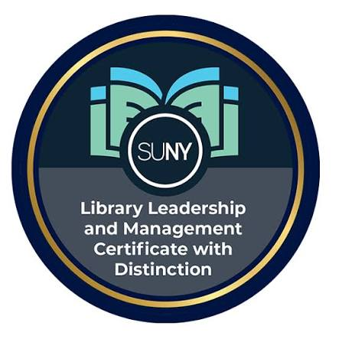

Policies:
ALA CORE policy*:
This policy limits the use of Generative AI tools by authors and prohibits use of Generative AI tools by peer reviewers for work under consideration by Core’s journals. The limitation on the use of AI tools to author articles is not meant to restrict research into potential uses of LLMs and/or Gen AI tools in libraries.
Authors: The use of is not allowed. In cases where such tools are used to support a human author’s writing or research, those uses MUST be acknowledged explicitly in the manuscript, including the specific tool(s) used, the prompts given, and the section(s) of the article that were enhanced in this manner.
Reviewers: The use of is not allowed. By using such tools, reviewers risk breaching confidentiality and giving away the author’s unpublished work to AI models.
Notes:
* https://www.ala.org/sites/default/files/2025-03/Core%20Publications%20-%20Generative%20AI%20Policy%2006.28.24.pdf?utm_source=chatgpt.com

Slide 10
resources
APA Science Student Council, “A Graduate Student's Guide to Determining Authorship Credit and Authorship Order” https://psychology.nd.edu/assets/198758/ContractWorksheet.pdf
APA worksheet - https://www.siue.edu/graduate/pdf/authorship-determination-scorecard.pdf
Cartoons: https://www.cartoonstock.com/
EMBO report: https://pmc.ncbi.nlm.nih.gov/articles/PMC3166465/
ISMJE on authors and contributions: https://www.icmje.org/recommendations/browse/roles-and-responsibilities/defining-the-role-of-authors-and-contributors.html
US Copyright office definitions: https://www.copyright.gov/help/faq-definitions.html?utm_source=chatgpt.com
US Copyright office on copyright and AI (Jan. 2025): https://www.copyright.gov/ai/Copyright-and-Artificial-Intelligence-Part-2-Copyrightability-Report.pdf?utm_source=chatgpt.com

