Slide 1
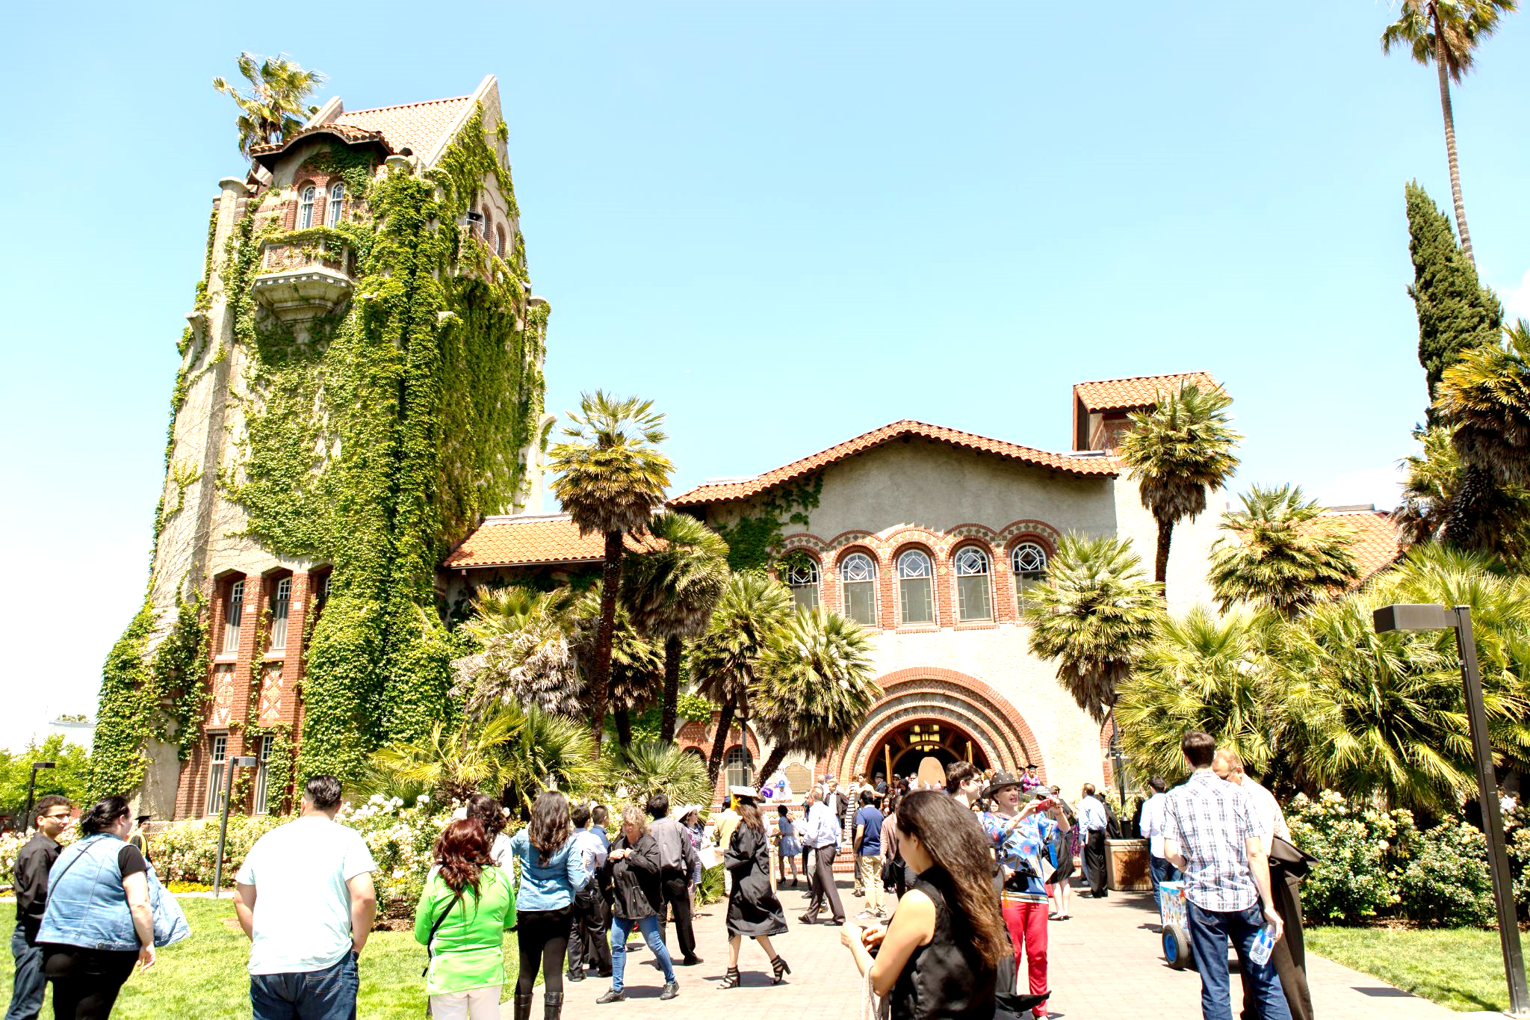
PRESIDENT’S REPORT
Academic Senate Meeting
March 17, 2025

Slide 2
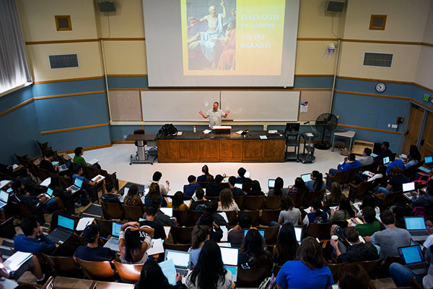
March 17, 2025
A Community of Care:
Continuing Our Commitment
Through Uncertainty

Slide 3
Themes for Priorities
March 17, 2025
Holistic Student Engagement – Goal 1
Transition to the next generation of GI2025 - the Year of Engagement Focus.
  3/4 - Met with Spartan Daily
  3/12 - Attended AS Board Meeting
Implement SJSU’s Well-being Collective, Well-being@SJSU: promote student health, career health, mental health, basic needs and well-being.
  Launched additional promotion of SJSU Cares across campus
Academic Excellence Advancement & WASC Accreditation (Goal 2)
Implement AI Vision and AI Pilot initiative.
  3/6 - Attending first AI Workforce Acceleration Board Meeting

Slide 4
Themes for Priorities
March 17, 2025
People Centered Excellence (Goal 3)
CSU
  Concur Travel
  CHRS readiness
Financially Sustainable Budget Model (Goal 4 & 5)
Transparent budget planning.
  Leading up to April 17th budget town hall, sent two messages updating the campus community of the current budget conditions
Diversify Revenue Sources:
  Cultivate and advance Strategic Partnerships, Alumni and Foundation to achieve philanthropic goals.
    2/26 - Orange County Alumni Event
Implement IT Strategic Plan, including classroom and study space assessment.
  $575K has been allocated for Phase 1 classroom technology upgrades, focusing on high-use spaces, with completion targeted by July 31, 2025; planning for future phases is underway.

