Slide 1
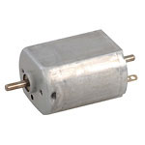
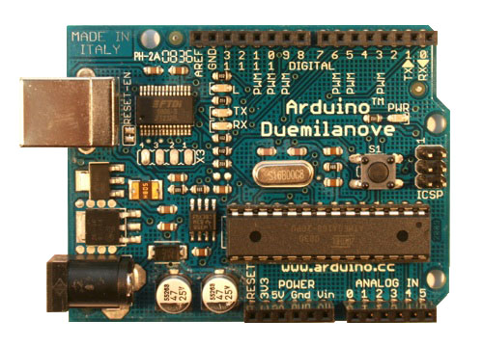
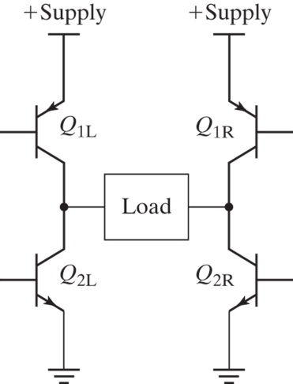
Interfacing to Control Power
BJ Furman
03MAR2016
http://arduino.cc/en/uploads/Main/ArduinoDuemilanove.jpg
https://www.jameco.com/Jameco/Products/ProdImag/1939589.jpg
Introduction to Mechatronics, Figure 17.16, p. 410.

Slide 2
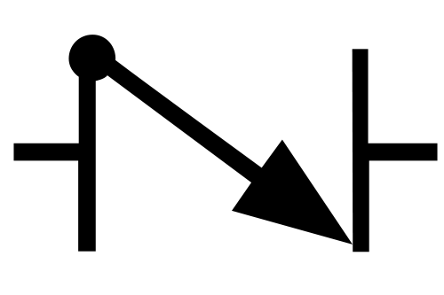

What does this symbol represent?
Check valve
Or
http://upload.wikimedia.org/wikipedia/commons/thumb/a/a1/Check_Valve.svg/500px-Check_Valve.svg.png
http://www.clippard.com/downloads/PDF_Documents/Application_and_Training/Clippard%20Schematic%20symbols.pdf

Slide 3
Outline
Learning objectives
Context for this module
Diodes
Bipolar junction transistors (BJT)
MOSFETs
Using transistors to control power

Slide 4
Learning objectives
Explain the theory, construction, and behavior of a diode
Explain the theory, construction, and behavior of a bipolar junction transistor (BJT)
Explain the theory, construction, and behavior of a MOSFET
Design an interface between a microcontroller and device that needs significant power

Slide 5
Context for this module
Mechatronics Concept Map
ME 106
ME 120
User
Interface
Power
Source
Controller
(Hardware & Software)
ME 30
ME 106
ME 190
ME 187
ME 106
Power
Interface
INTEGRATION
‘Muscle’
Signal
Conditioning
ME 106
ME 120
ME 106
ME 154
ME 157
ME 195
Actuator
Sensor
ME 120
ME 284
System to
Control
ME 110
ME 136
ME 154
ME 157
ME 182
ME 189
ME 195
BJ Furman 22JAN2011

Slide 6
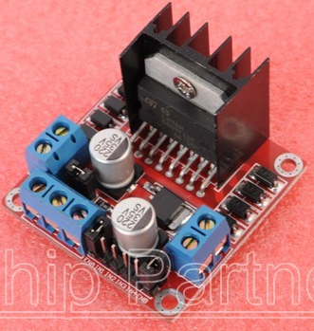
Diode Types and Circuit Symbols
Diode Types
  Signal Diodes
  Rectifier Diodes
  Transient Voltage Suppress (TVS) Diodes
  Light Emitting Diodes
  Zener Diodes
Symbol:
Anode
(P)
Cathode
(N)
Actual Device:
Anode
(P)
Cathode
(N)
http://www.ebay.com/itm/Dual-H-Bridge-DC-Stepper-Motor-Drive-Controller-Board-Module-L298N-for-arduino-/251080674810
Surface mount

Slide 7
P-N Junction – Forward Bias
A Diode
is formed by
A junction between positively and negatively doped semiconductor material
P Type
  Doped with Boron or Gallium
  (1 Less e⁻)
Anode
(P)
Cathode
(N)
N Type
  Doped with Arsenic or Phosphorous
  (1 Extra e⁻)
P N
Holes
e⁻
Net current
+ -

Slide 8
P-N Junction – Reverse Bias
P Type
  Doped with Boron or Gallium
  (1 Less e⁻)
Anode
(P)
Cathode
(N)
N Type
  Doped with Arsenic or Phosphorous
  (1 Extra e⁻)
P N
Holes
e⁻
No net current
- +

Slide 9
I-V Characteristic for a Diode (non-linear)
Anode
(P)
Cathode
(N)
= 1/R
I
IV Characteristic for a Resistor
Reverse Bias
Cathode voltage higher than anode voltage
V
Breakdown Voltage
50-1000V
0.6 to 0.7 V for silicon diode,
For LED ~ 1.5 V (IR) – 3.8 V (Blue)
Forward Bias
Anode voltage higher than cathode voltage
Why do you need a resistor in series with a diode?

Slide 10
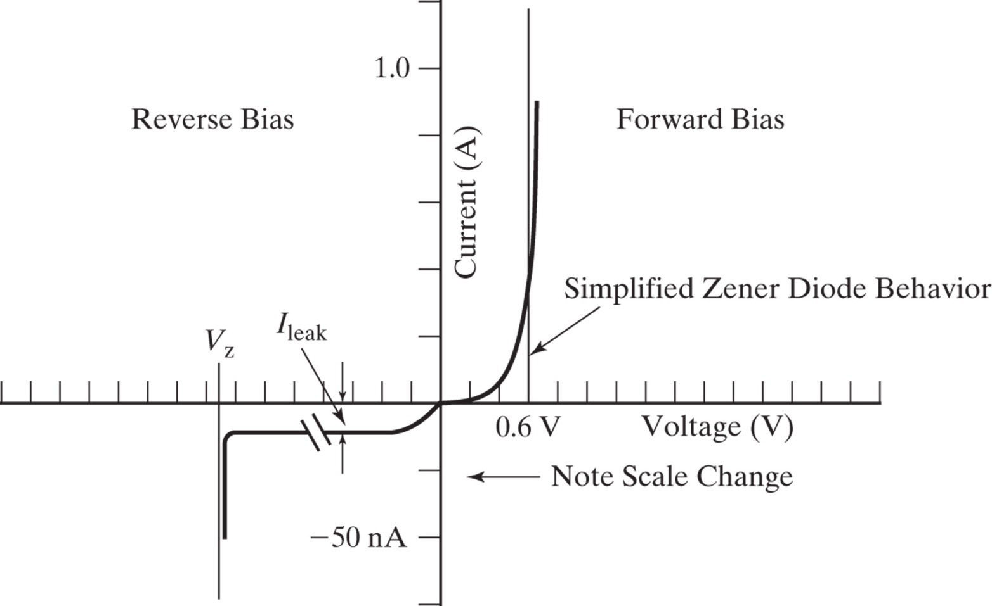
I-V Characteristic for a Zener Diode
Anode
(P)
Cathode
(N)
Introduction to Mechatronics, Figure 10.8, p. 203.

Slide 11
Diode Example 1
Find V_{D}, I_{R}, V_{R,} R = 1Ω (assume Vf = 0.7 V, and look closely at the diagram)
+ VD -
-
10V
+
+
VR
-
IR
V_{D} = -10V, V_{R} = 0, I_{R} = 0

Slide 12
Diode Example 2
Find V_{D}, I_{R}, V_{R} , R = 1Ω (assume Vf = 0.7 V)
+ VD -
V_{D} = 0.7V
V_{R} = 10 – 0.7 = 9.3V
I_{R} = 9.3 / 1 =9.3A
+
10V
-
+
VR
-
IR

Slide 13
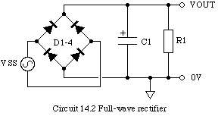
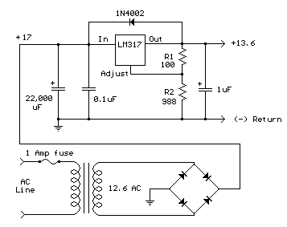
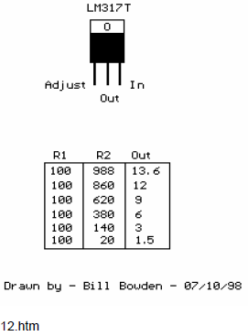
Diode Applications
+ VD -
AC Rectification
  Half wave
+
10V
-
+
VR
-
~
IR
  Full wave
http://newton.ex.ac.uk/teaching/CDHW/Electronics2/PHY2028-C14.2.gif
http://www.bowdenshobbycircuits.info/page12.htm#317.gif

Slide 14
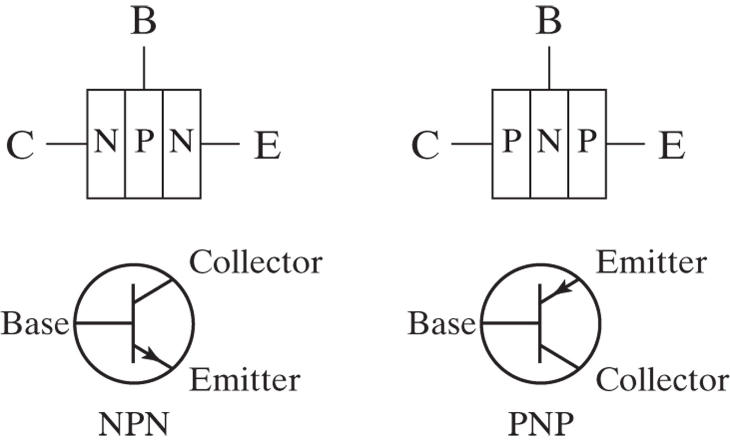
Bipolar Junction Transistor (BJT)
Construction and schematic
Introduction to Mechatronics, Figure 10.15, p. 206.
So, B-C and B-E junctions look like…?
  Remember this!
Notes:
Look at the slices of semiconducting material (say for the NPN-type): between B and C – a P-N junction, and between B and E – a P-N junction. What is a P-N junction? A diode. You will get current flow from B to E if you forward bias (hold B at a voltage higher than E by about 0.7 volts).

Slide 15
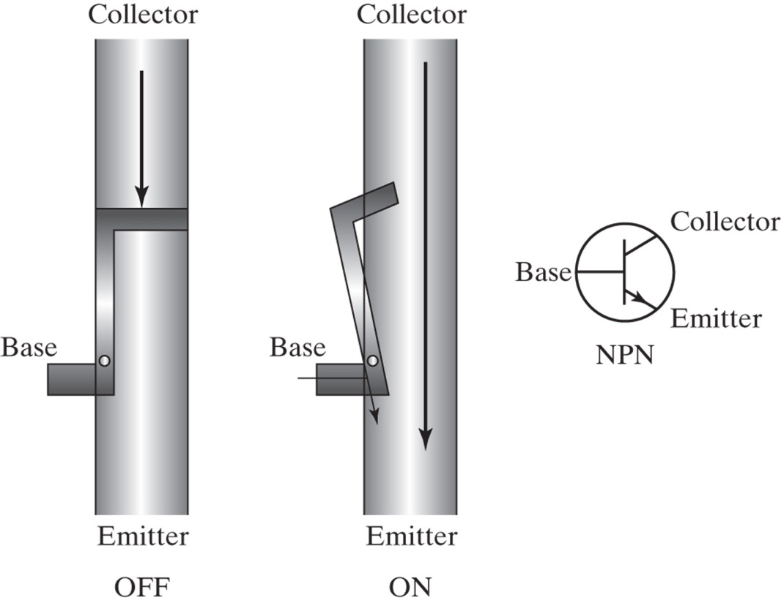
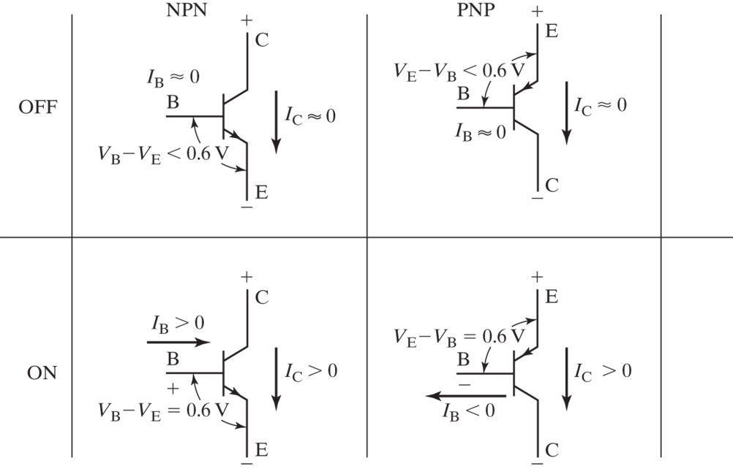
BJT Operation (conceptual)
Like a current-controlled valve where base-emitter current controls collector-emitter current
  Hydraulic analogy for NPN
  How much ‘pressure’ (i.e., voltage, V_{BE}) is needed to cause i_{BE}?
Introduction to Mechatronics, Figure 10.16 p. 206.
Key concepts
Must turn on B-E diode to get C-E current
I_{c} = h_{fe}I_{B} (up to saturation)
Introduction to Mechatronics, Figure 10.17 p. 207.
Notes:
The flow of current from base to emitter enables a larger flow of current from collector to emitter. The condition where the Vbe is less than 0.7 V is called the ‘cut-off’ region. In this region, there is not enough pressure to open the BE ‘check valve’, so no BE current flows. Consequently, the CE ‘valve’ will be closed, and no Ice current will flow. If Vbe is large enough to get current flowing from B to E, then the CE ‘valve’ opens in proportion to the BE current, but only up to the point that the valve is fully opened. This region of operation is called, ‘the linear region’, because Ice = hfe*Ib (roughly). That is, Ice is approximately proportional (linear) to Ibe by a proportionality constant called hfe, the ‘dc current gain’. Now there comes a point where the CE valve is fully opened, and further increase in Ibe does not produce more Ice. This point is called saturation. When the transistor is saturated, the Ice will depend on the voltage urging Ic current, the Vce_sat, and whatever is restricting current flow from C to E. hfe is on the order of 30 to 1000 depending on the transistor

Slide 16
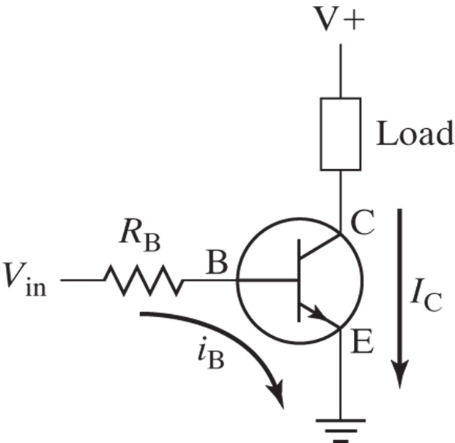
BJT low-side drive
For mechatronics, transistors are mostly used as electronically controlled switches
  Either fully off (cut off) or fully on (saturated)
    Want to avoid the in-between condition (linear region). Why…?
      Minimize power dissipation in the transistor
Consider
h_{fe}= 100 (current gain)
V⁺= 12 V
V_{ce(sat)}= 0.3 V
R_{B}= 10 kohms
R_{load}=500 ohms
Plot V_{ce}, I_{c}, P_{t}, and P_{load} vs. V_{in}
Introduction to Mechatronics, Figure 10.18 p. 207.

Slide 17

BJT low-side drive example
Find R_{B} to turn on the lamp (R_{load})
  R_{load}= 100 ohms
  V_{ce(sat)}= 0.3 V
  V⁺= 10 V
  V_{in} = 5.0 V
Introduction to Mechatronics, Figure 10.18 p. 207.
Procedure
Work backward starting with the load. Find a candidate transistor that can handle the required I_{CE} current and V_{CE} voltage.
  What I_{c} is needed for saturation?
  Find a transistor that will handle I_{c} and V⁺ (data sheet)
  Determine h_{fe} and V_{ce(sat)} at I_{c(sat)} from the data sheet
  Determine i_{B(minimum)} to saturate the transistor:
  Select R_{B} to give i_{B} with some extra margin (2x – 10x):
Notes:
Make this an exercise.
We usually know what voltage and current the load needs. A quick estimate of the maximum current that could be delivered to the load can be found by applying Ohm’s law across the load V/R_{load.} To be more accurate, once we select a candidate transistor, we can find V_{CE_sat} from the data sheet and use it to find I_{c_sat,} then work backward from the point of saturation to determine the base current, and then the base resistor value to insure that the transistor will always be driven into saturation.

Slide 18
Review – Interfacing to Control Power
BJT (NPN and PNP)
  Current-controlled ‘switch’
    Controlled by base-emitter current
    Base emitter junction acts like a diode
      For NPN, need V_{BE} > 0.6-0.7 V to get base-emitter current
  i_{c} = h_{fe}*i_{b} up to saturation
  For our purposes, use BJT either cut-off or saturated
  Work backward from the saturation current
    Choose a BJT that can handle the current and voltage
    Determine the size of the base resistor, so that the microcontroller can drive the BJT into saturation
      Include some margin to guarantee saturation

Slide 19
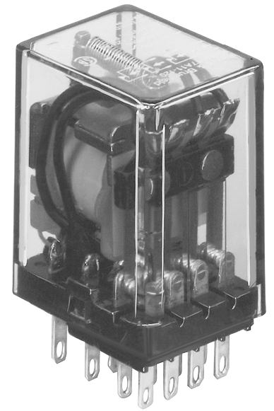
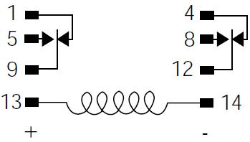
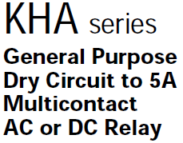
Example – Arduino to AC motor
Design an interface between the Arduino and a motor that requires 120 VAC, 2A

Slide 20
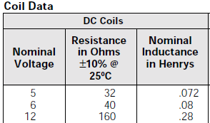
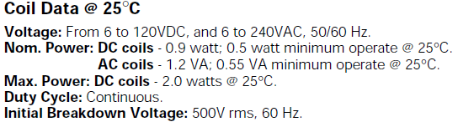
Design the interface to the relay coil
How much current is needed?

Slide 21
Configure the components

Slide 22
Calculations – Follow the procedure
What current is needed to operate the relay?
  Coil voltage/coil resistance
What kind/size transistor is needed?
  Max. continuous current
  Max collector voltage
  h_{fe}
What should Rb be?
  Choose to make sure that transistor is driven into saturation
    i_{b} should be 2x – 10x what is needed to saturate
  Make sure that Arduino can supply the current
Add transient current protection (what is that?)
Notes:
Data sheet for the relay said that Rcoil = 32 ohm, which, if driven at 5 V will need 5V/32 ohm = 0.156 A
Max collector voltage will be 5 V
hfe min =

Slide 23
Configure the components

Slide 24
Possible choice of transistor
2N3904
  See the data sheet
2N2222
  See the data sheet
ULN2803D
  See the data sheet
Prelim design
Final design

Slide 25
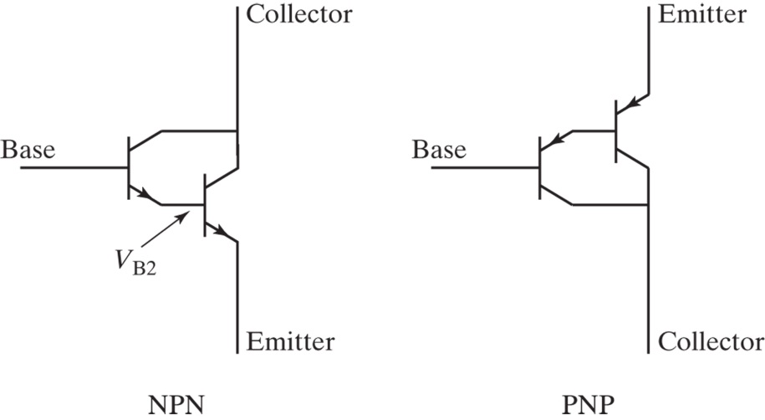
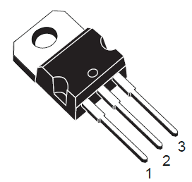
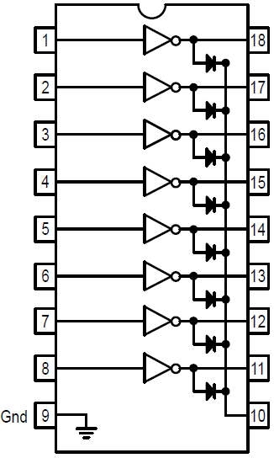
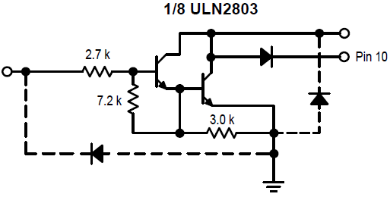
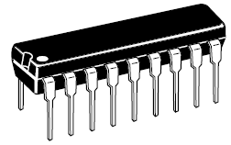
The Darlington pair
Provides higher current gain
  For NPN VBE will be about 1.2 V
  Current gains in saturation are about 200 to 500:1
Popular versions
  TIP100 series
    TIP120
  ULN2803 Octal driver
Introduction to Mechatronics, Figure 10.24 p. 211.
ST TIP120 data sheet
Motorola ULN2803 data sheet
Notes:
Make this an exercise.

Slide 26
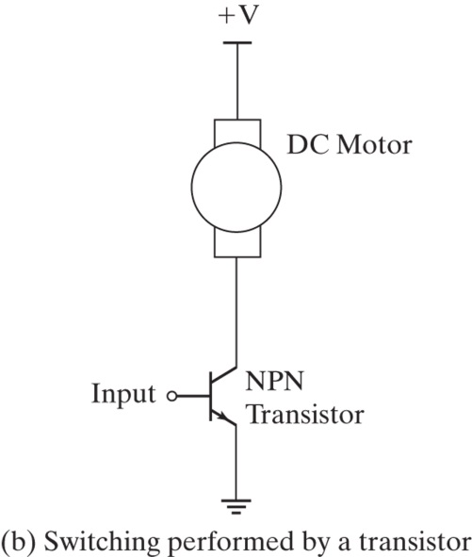
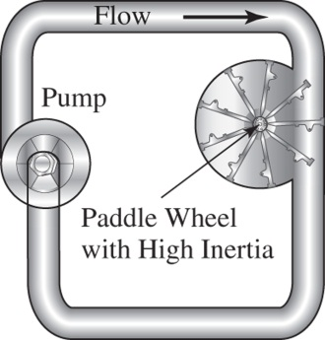
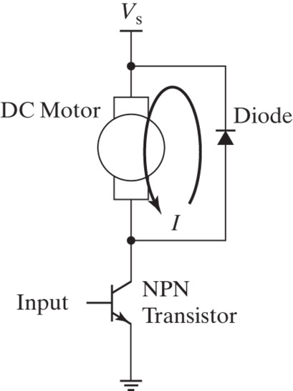
Switching loads with having appreciable inductance
You must protect the transistor switch from transient voltages when driving inductive loads
  Motors, solenoids, etc. have
  relatively large inductance
    Inductance is analogous to…?
      Inertia
  Problem arises when turning the switch off
    Collapsing magnetic field will create a transient voltage spike
      Ex. L=200 μH, 0.65 A, 1μs switching time
  Need a way to dissipate the energy
    Use a diode (at the very least)
    Diode plus Zener diode or TVS diode better
BIG Problem!
Introduction to Mechatronics, Figure 23.1 p. 553.
Introduction to Mechatronics, Figure 23.4 p. 553.

Slide 27
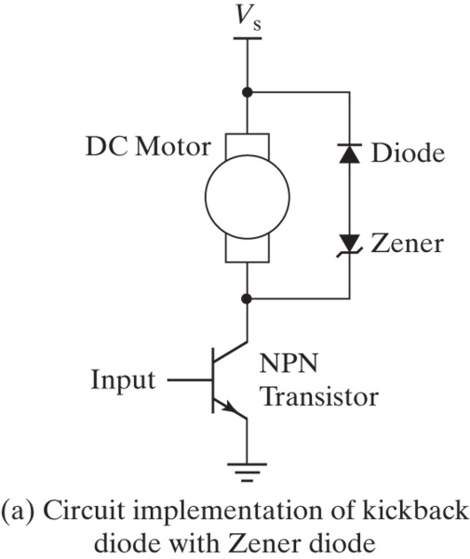
Choosing the transient suppression components
Simple diode
  Fast recovery time, t_{rr}
    A few hundred nanoseconds or less
    Ex. 1N4933
  Select diode so that its peak intermittent current is greater than the maximum current you need to switch off
Simple diode plus Zener diode
  Choose the Zener so that its reverse-breakdown voltage does not exceed the V_{CE} or V_{DS} maximum of the transistor and that it can handle the maximum current that will be switched off
TVS diodes
  http://www.littelfuse.com/data/en/Product_Catalogs/Littelfuse_TVS_Diode_Catalog.pdf
Introduction to Mechatronics, Figure 23.4 p. 553.
Introduction to Mechatronics, Figure 23.7 p. 558.

Slide 28
The interface design
Back

Slide 29
Interface with ULN2803

Slide 30
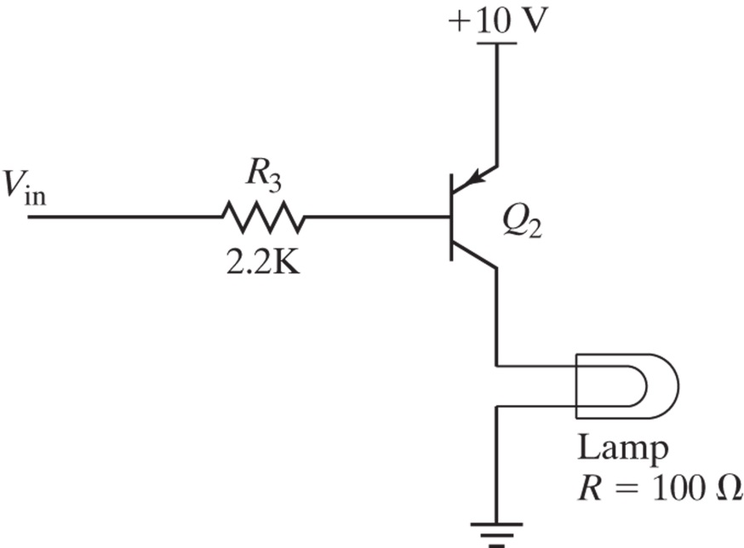
BJT high-side drive
If load must be referenced to
ground
Uses a PNP transistor
  Turn on by making V_{in} at least 0.6 V lower than +10 V
  Turn off by making V_{in} at least +10 V - 0.6 V
Would this work with the Arduino?
Introduction to Mechatronics, Figure 10.23 p. 210.
Notes:
Make this an exercise.
Use an NPN transistor with its collector tied (through a current limiting resistor) to 10 V and to Vin. To turn on the lamp, write HIGH to the pin connected (through a current limiting resistor) to the base of the NPN transistor.

Slide 31
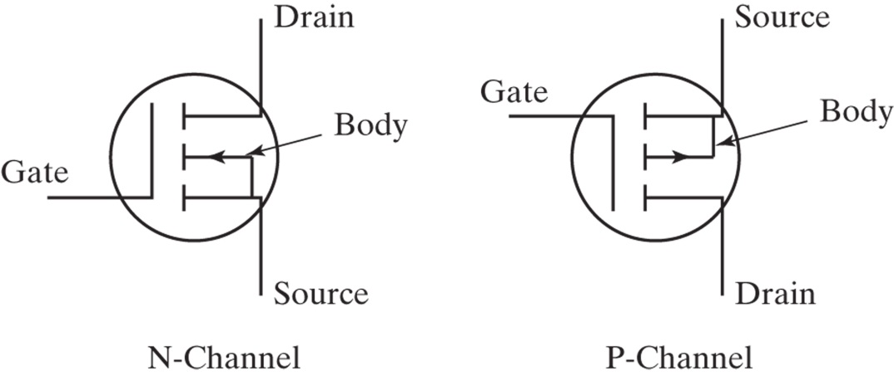
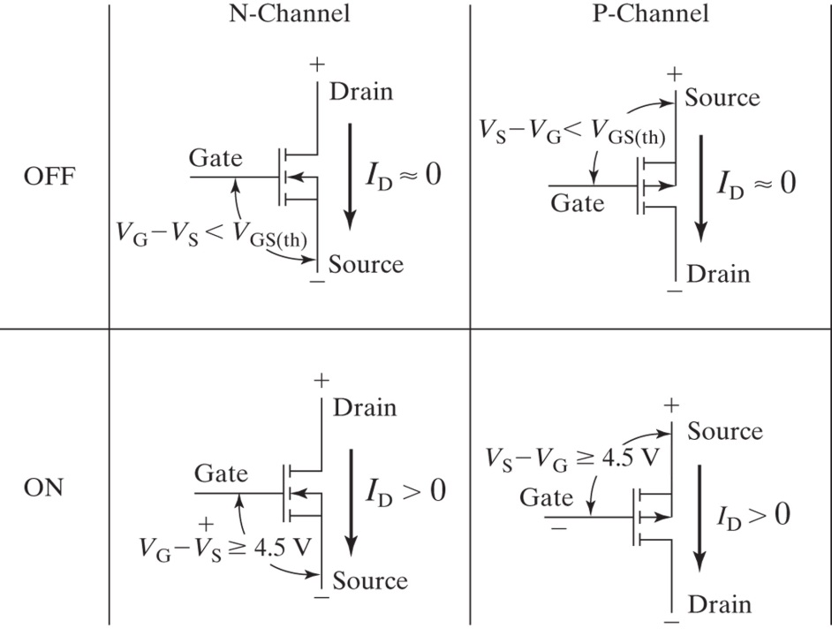
The MOSFET
Metal Oxide Semiconductor Field Effect Transistor
  Distinctions from BJT
    Voltage controlled, rather than current controlled as for the BJT
    Conduction path (D-S) behaves like a small resistance rather than a fixed voltage drop when fully on
    Enhancement and depletion types
  Gate-source voltage controls drain-source current
    N-channel (enhancement) fully turns on when V_{GS} > V_{On}
      V_{On} = 4.5 V for logic-level types, 10 V for non-logic level types
    P-channel (enhancement) turns on when V_{SG} > V_{On}
    R_{DS} drops to a relatively low value when device is fully on
      mOhms for power MOSFETs
Introduction to Mechatronics, Figure 10.27 p. 213.
Introduction to Mechatronics, Figure 10.28 p. 213.
Notes:
Make this an exercise.

Slide 32
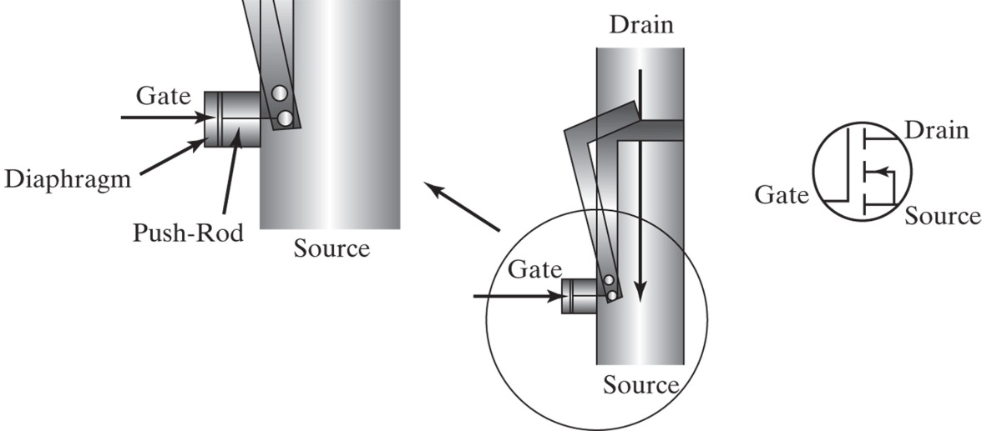
The MOSFET (hydraulic analogy)
Gate to source ‘pressure’ (voltage) controls drain-source flow restriction (R_{DS})
  Small gate capacitance
    Small transient current to build up V_{GS}, but none needed in steady state
Introduction to Mechatronics, Figure 10.29 p. 213.
Notes:
Make this an exercise.

Slide 33
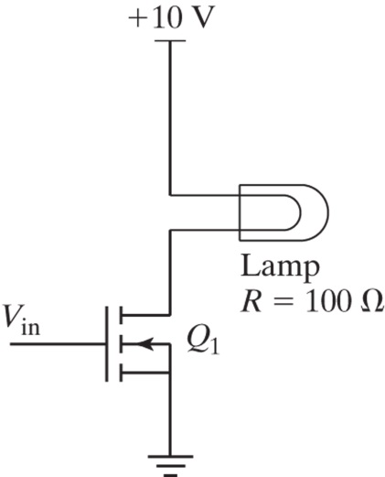
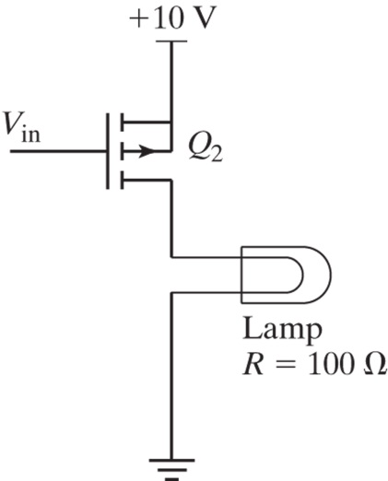
MOSFET high and low-side drive examples
Low-side drive
  Use an N-channel MOSFET
    For ‘logic level’ MOSFET, V_{GS} should be about 5 V to achieve low R_{DSon}
    For regular power MOSFET, V_{GS} should be about 10 V to achieve low R_{DSon}
High-side drive
  Use a P-channel MOSFET
    For ‘logic level’ MOSFET, V_{GS} should be about -5 V to achieve low R_{DSon}
    For regular power MOSFET, V_{GS} should be about -10 V to achieve low R_{DSon}
Low-side drive
Introduction to Mechatronics, Figure 10.32 p. 215.
High-side drive
Introduction to Mechatronics, Figure 10.33 p. 216.
Notes:
Make this an exercise.

Slide 34
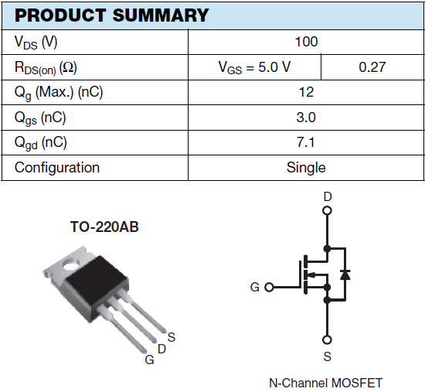
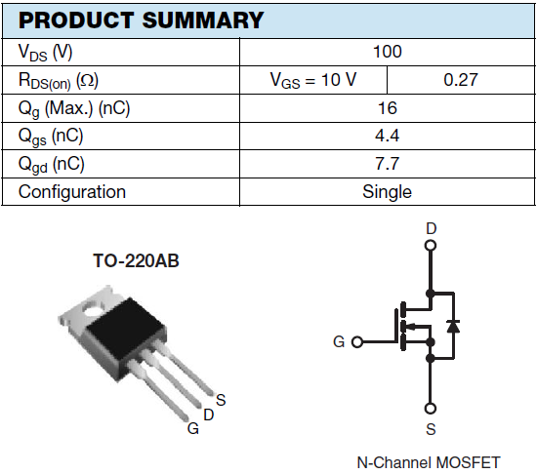
Logic Level vs. ‘regular’ Power MOSFET
IRL520
IRF520
http://www.vishay.com/

Slide 35
BJT vs. MOSFET – which to use?
Depends on how much control voltage and current is available
  Some overlap where either type could be used
    Decide based on cost, complexity, and efficiency
  BJT advantages
    When control voltage is relatively small (i.e., less than 3 V)
    Higher voltage switching capability
  MOSFET advantages
    When lowest voltage drop or lowest power dissipation across the switch is required
    When sufficient voltage is available, but not sufficient control current
      Gate drivers are available (ex. LTC1157)
    Less complex (no extra resistor), but may be more expensive

Slide 36
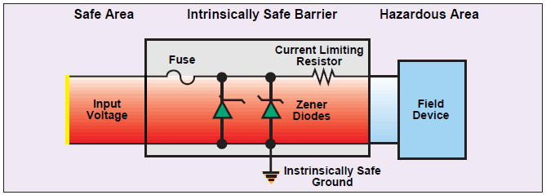
Intrinsically Safe Circuits
http://www.omega.com/temperature/z/pdf/z131-148.pdf

Slide 37
For More Information
Transient Suppression Devices and Principles
      http://www.littelfuse.com/data/en/Application_Notes/an9768.pdf
The application of relay coil suppression with DC relays
      http://relays.te.com/appnotes/app_pdfs/13c3311.pdf
Coil Suppression Can Reduce Relay Life
      http://relays.te.com/appnotes/app_pdfs/13c3264.pdf
Determining Relay Coil Inductance
      http://relays.te.com/appnotes/app_pdfs/13c3344.pdf

Slide 38
Review from last lecture
BJT used as an ‘electronic switch’ to control power
Two ‘flavors’ of BJT
  NPN
    Turn on with V_{be} > 0.6 V
    I_{ce} is controlled by i_{be} up to saturation
    Up to saturation, i_{c} = h_{fe}*i_{b}
    Make sure that transistor IS driven into saturation
  PNP
    Turn on with V_{eb} > 0.6 V
    Currents flow oppositely to NPN

