Slide 1
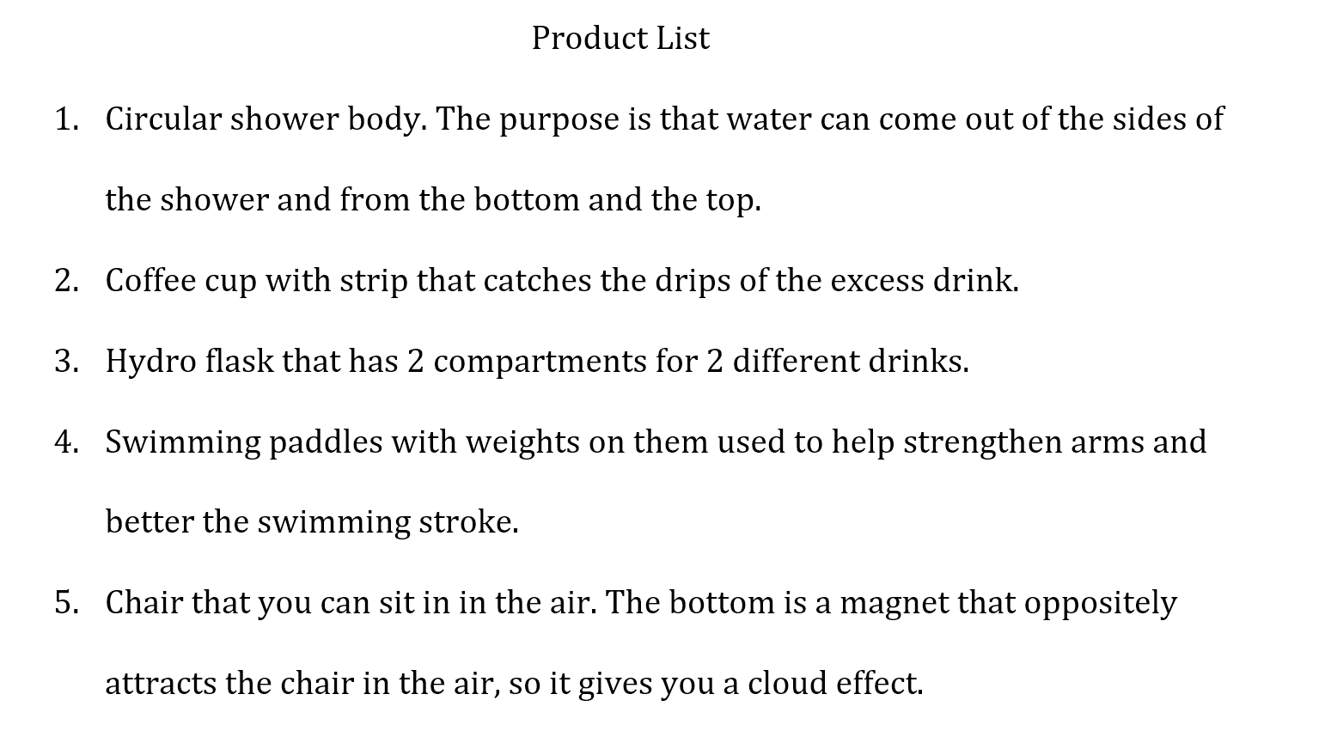
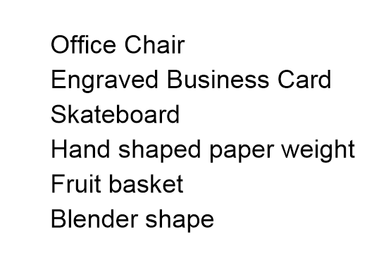
Product list is due next week Friday Sept. 25 by 11:59 pm. Upload your list to Canvas.
You are asked to come up with 5 ideas for either new products or modification of an existing product. The list should only be ideas that can be built physically
√
Not enough explanation
X
√
X
√

Slide 2
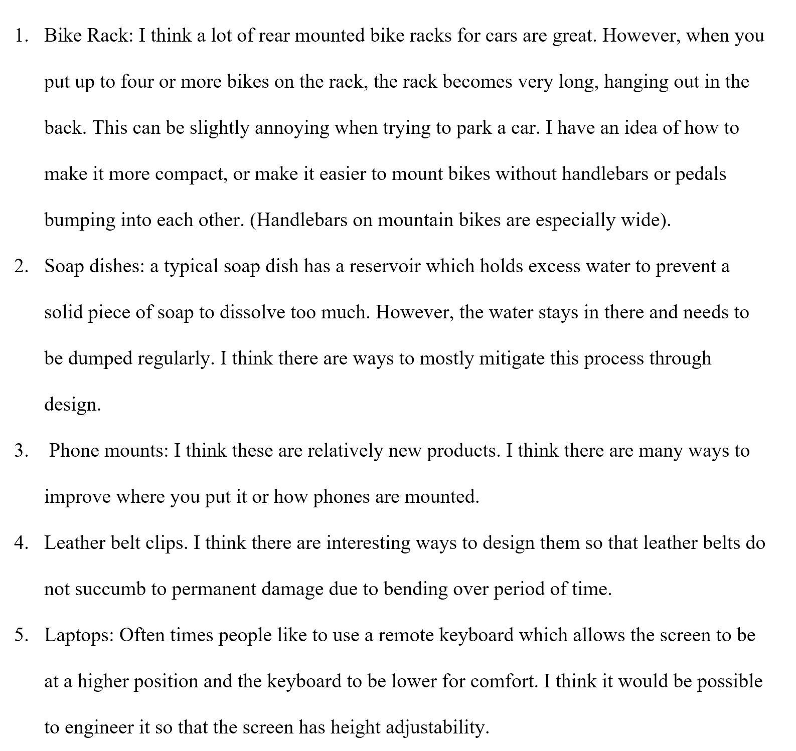

Slide 3
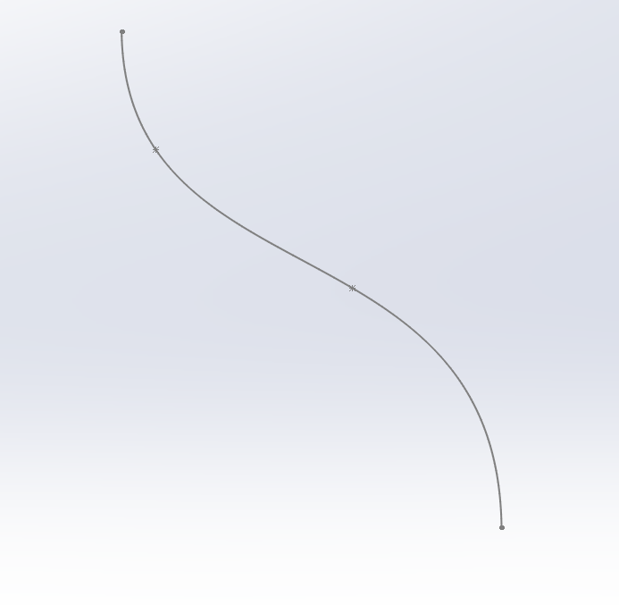
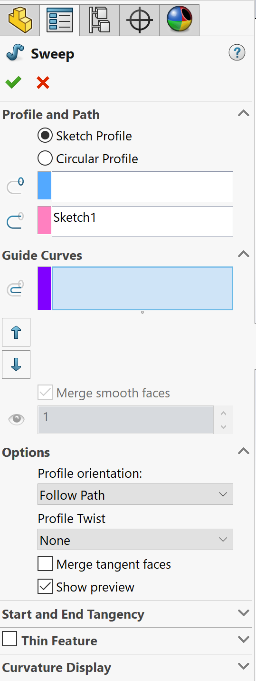
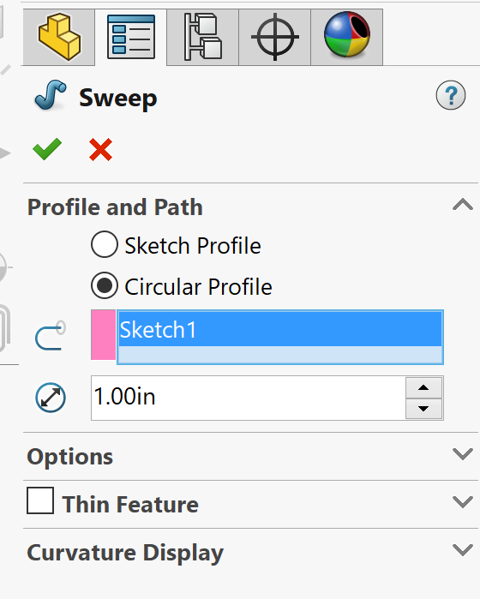
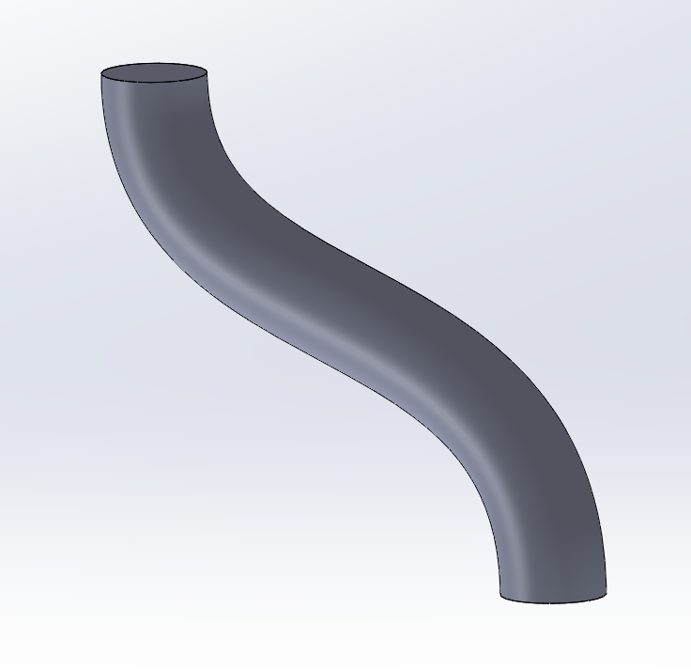
Sweep Command in SW
Circular Profile – automatically uses a circle as the Profile.

Slide 4
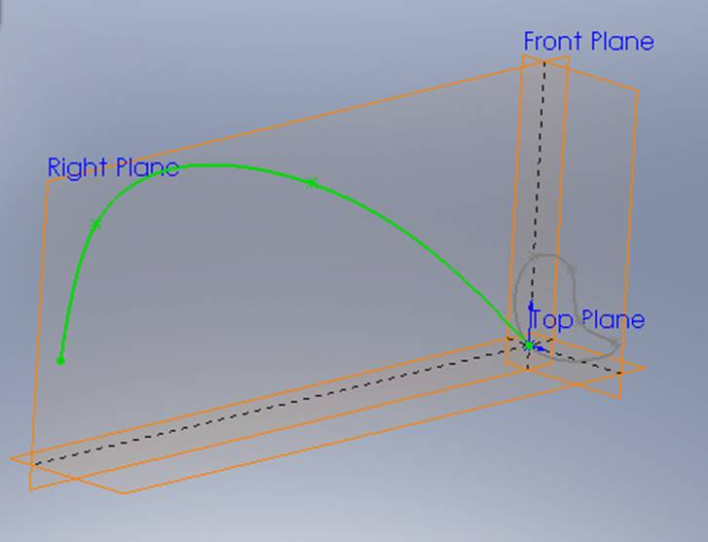
Sweep Command in SW
Sweep needs a profile (section) and a path (guide)
The guide must intersect the section
Path
Profile

Slide 5
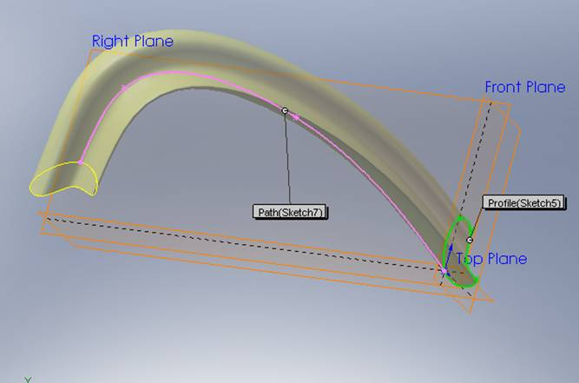
Sweep using a profile, path and Follow Path option
Profile (Sketch 5)
Path (Sketch 7)

Slide 6
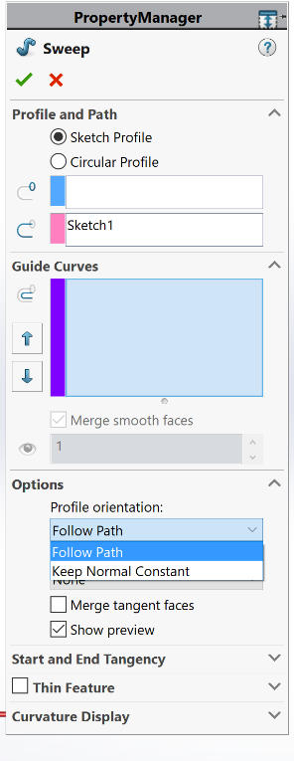
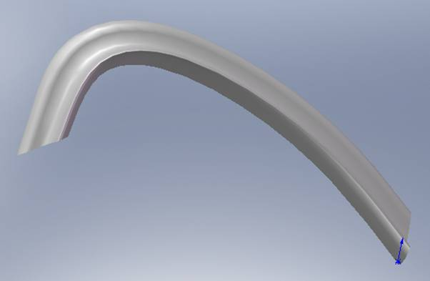
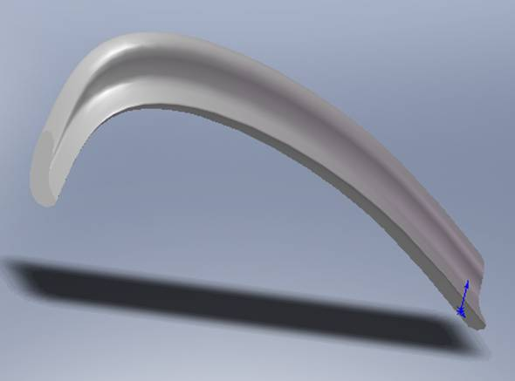
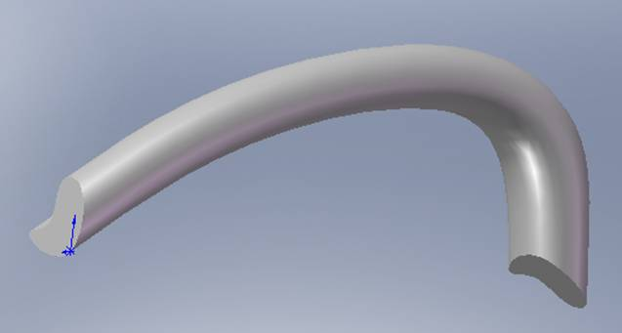
Sweep Command in SW
Sweeps using different Options
Follow Path
Keep normal constant
Twisted

Slide 7
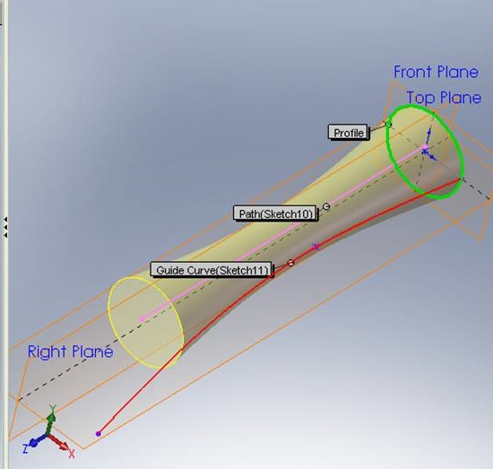
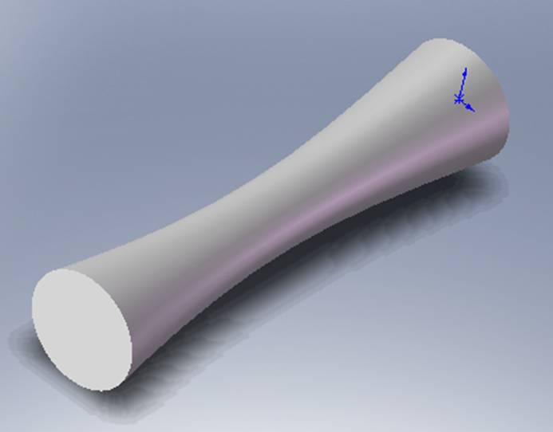
Sweep Command in SW
Sweep using a profile, path and one guide
1
1
Profile
Profile
Sketch10
2
Sketch11
3
2
Path
3
Guide curve 1

Slide 8
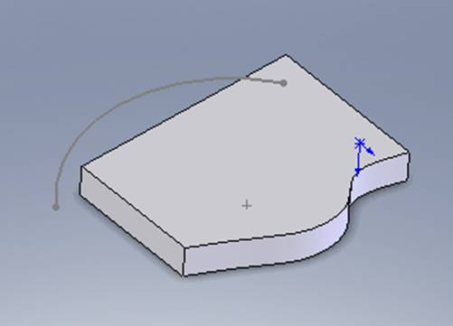
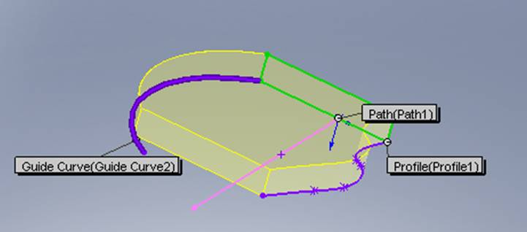
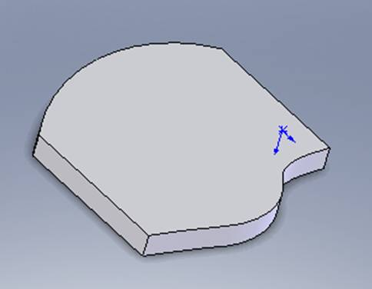
Sweep Command in SW
Sweep using a profile, path and two guides
Profile 1
Path 1
Guide Curve 1
Guide Curve 2

Slide 9
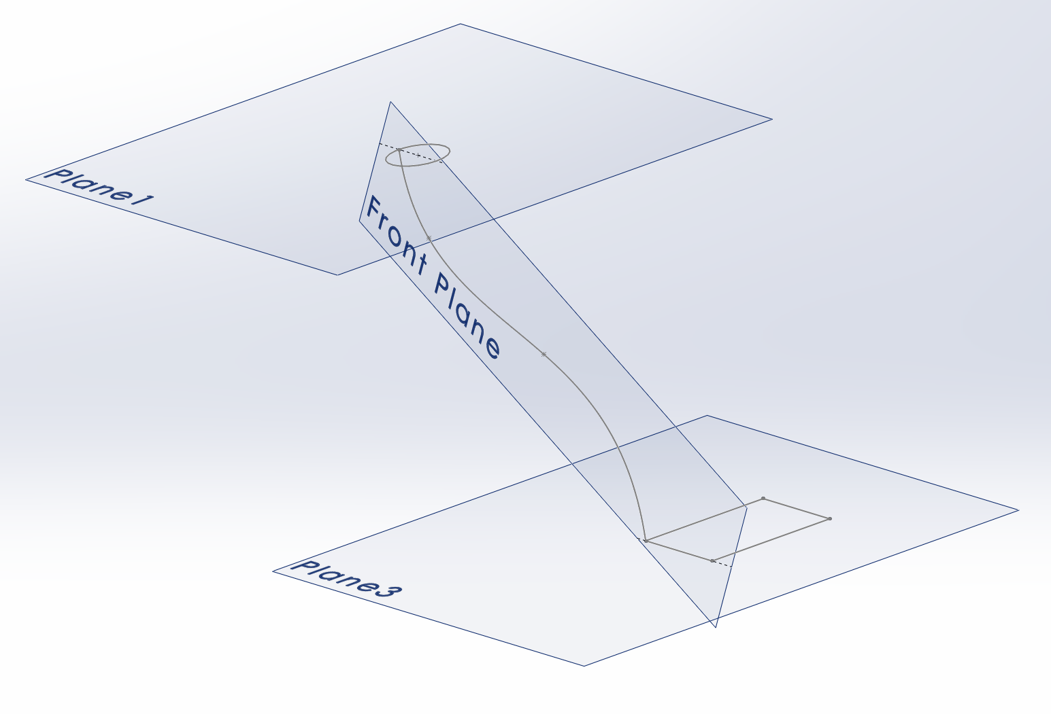
Loft Command in SW
Loft command creates a surface or a solid by sweeping and blending using two or more different profiles.
Profile 1
Draw the guide curve first then create two reference planes at the ends of the guide curve perpendicular to the curve
Guide curve
Profile 2

Slide 10
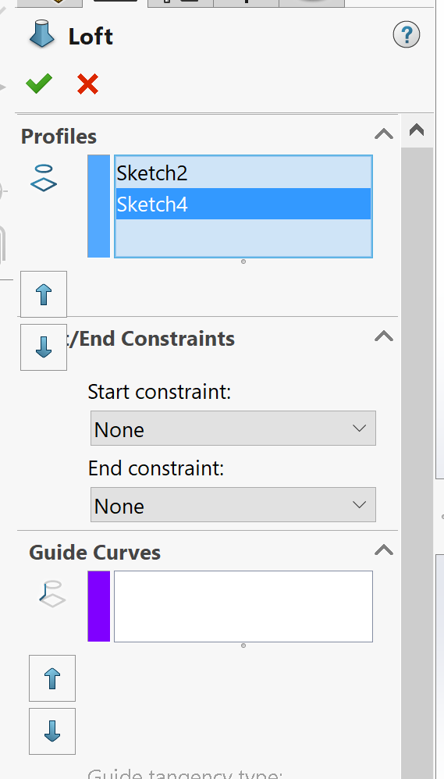
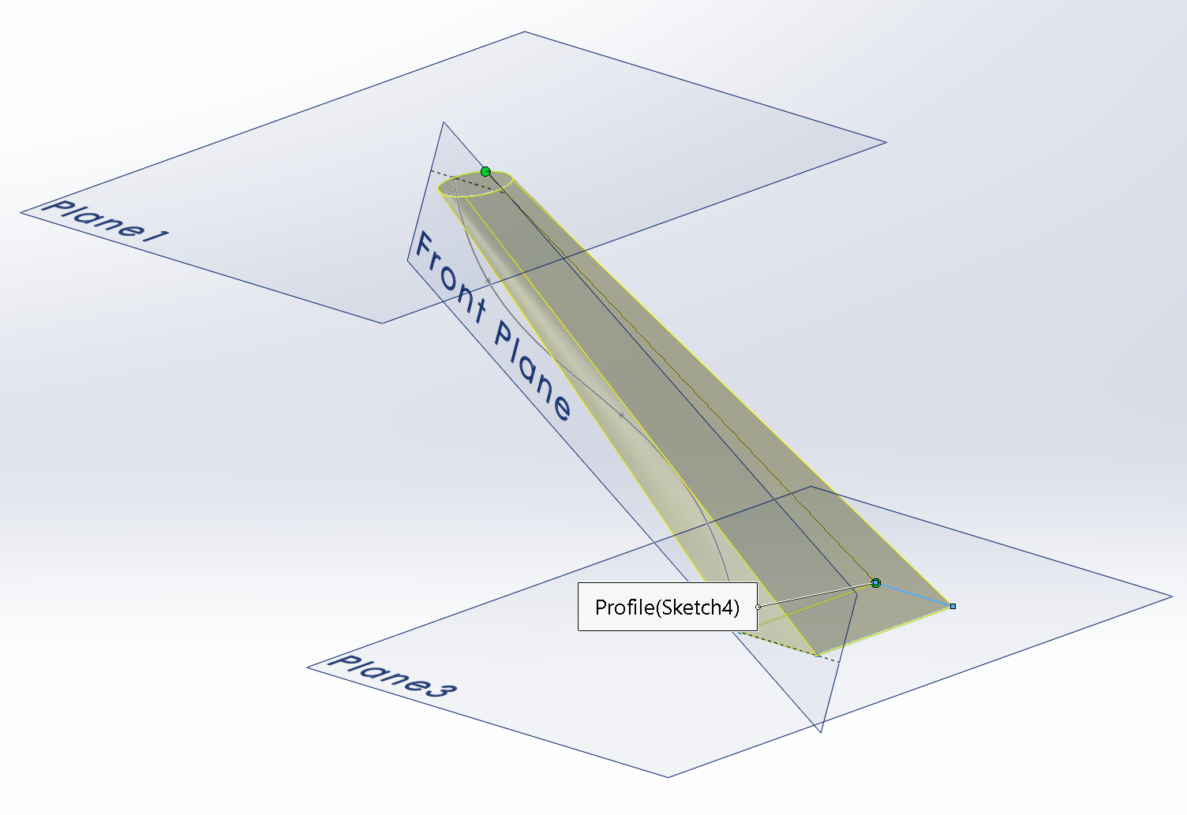
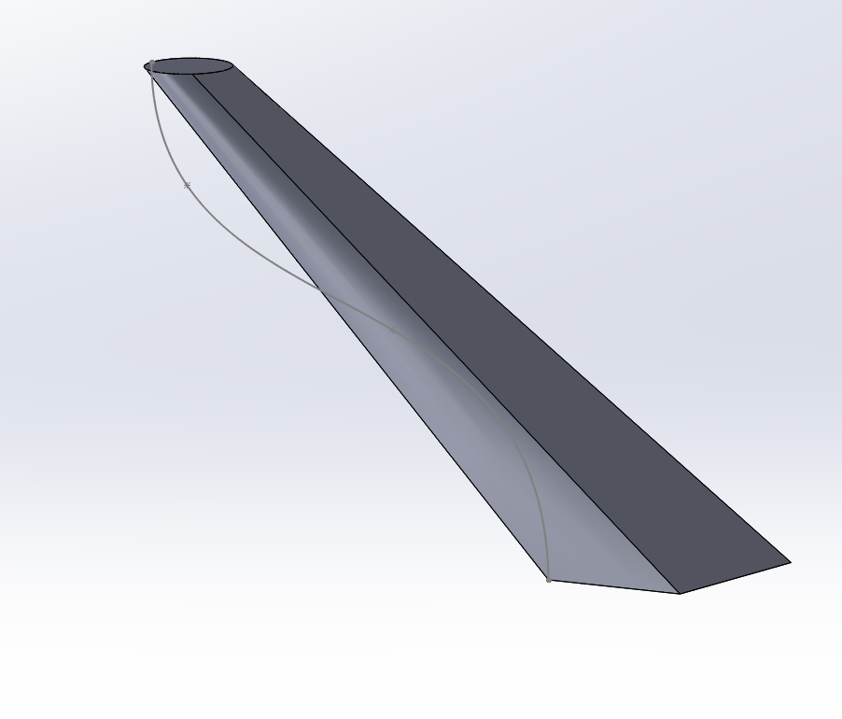
Loft without any guide curve

Slide 11
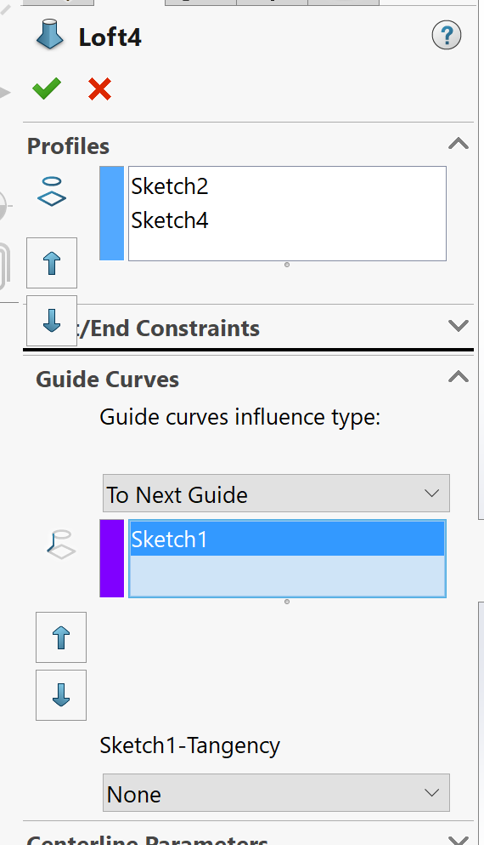
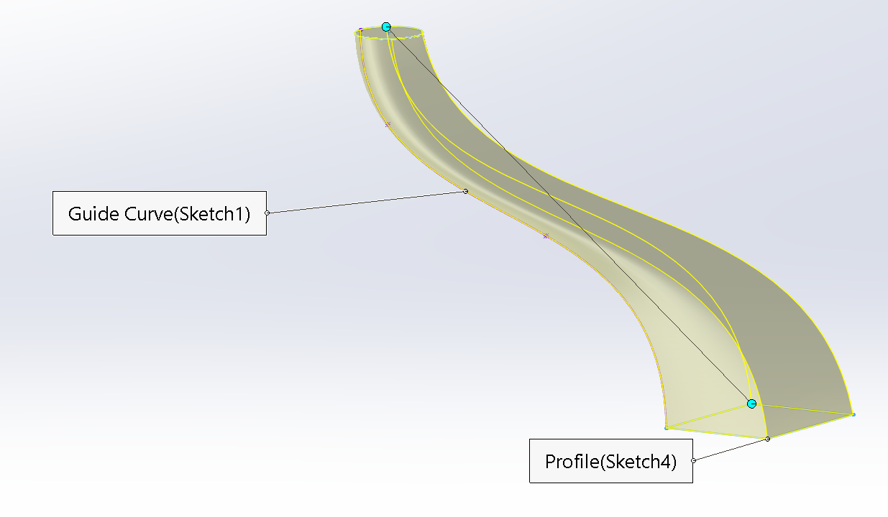
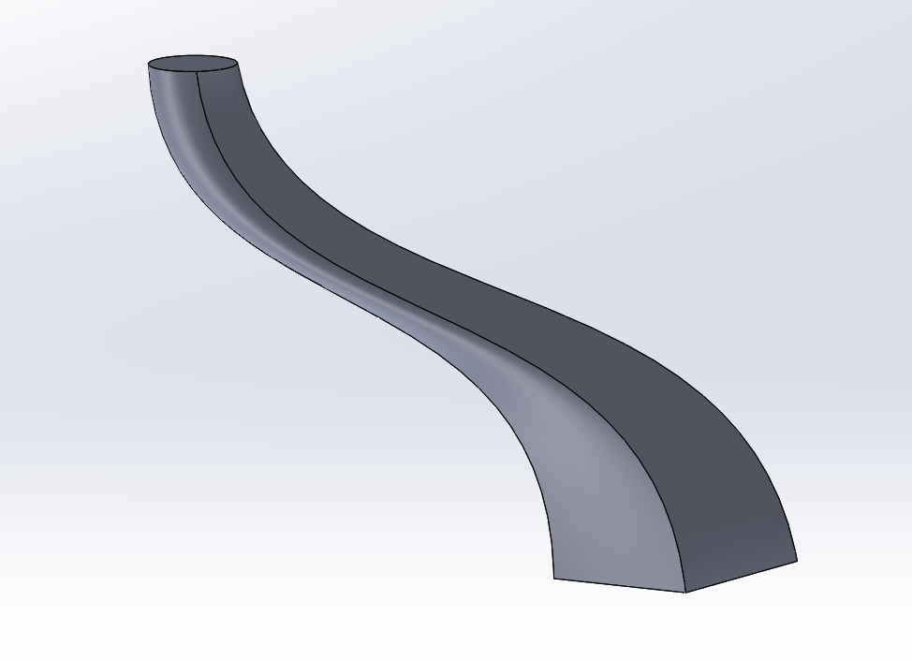
Loft using a guide curve

Slide 12
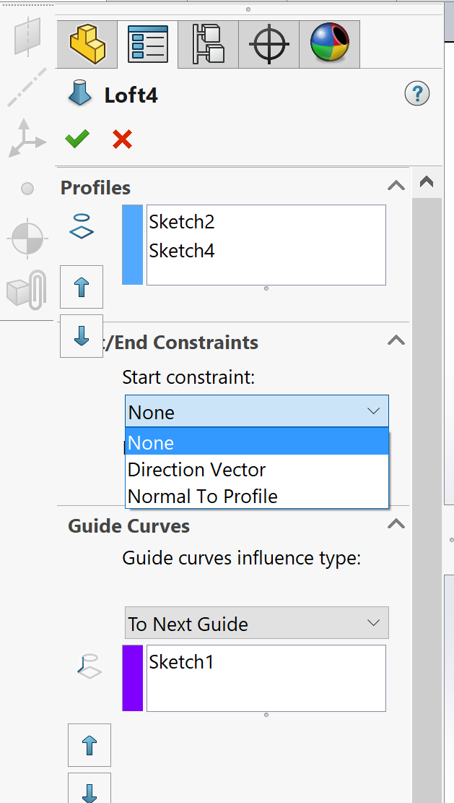
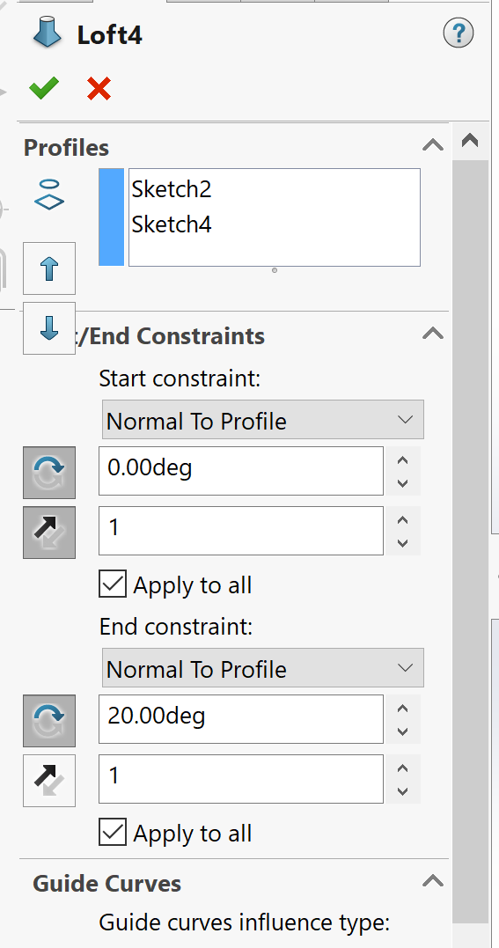
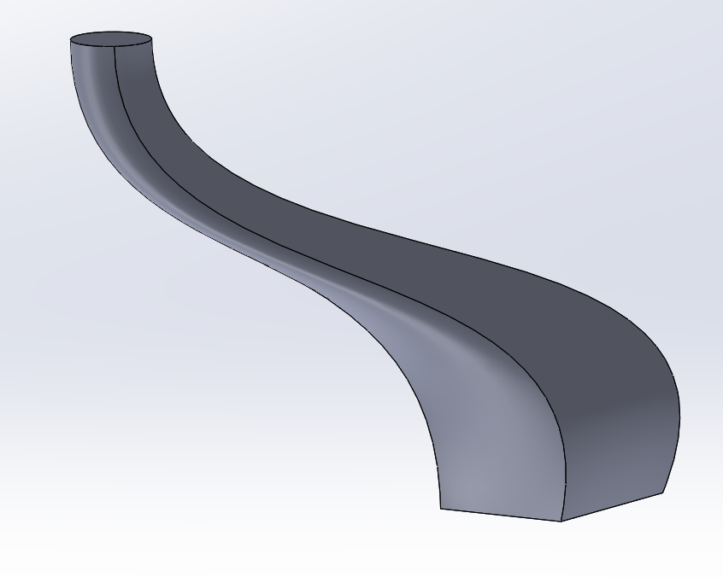
None or normal to Profile with 0 angle at both ends
End Constraints
Normal to Profile with 0 angle at top but 20º at the bottom

Slide 13
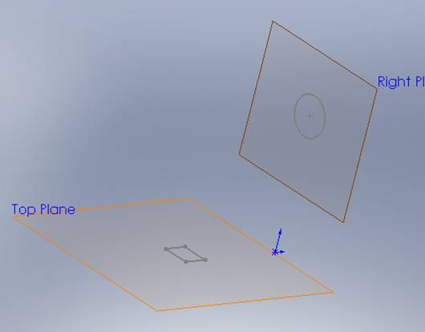
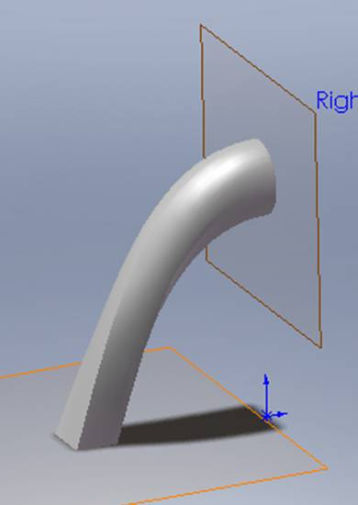
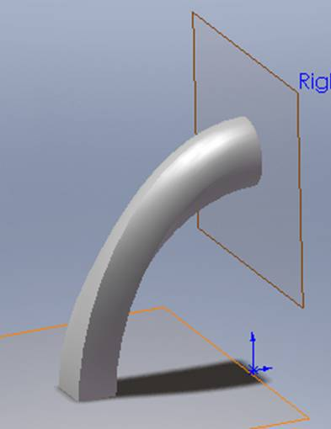
Loft Command in SW
Profile normal to the plane at one end
Profile normal to the plane at both ends

Slide 14
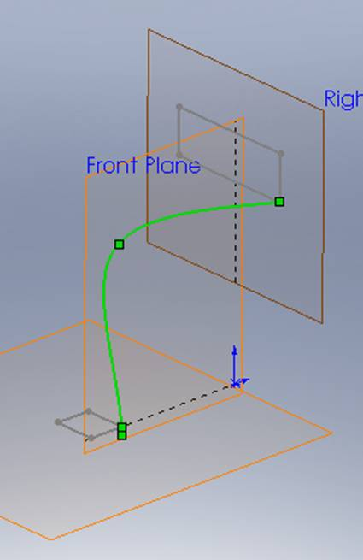
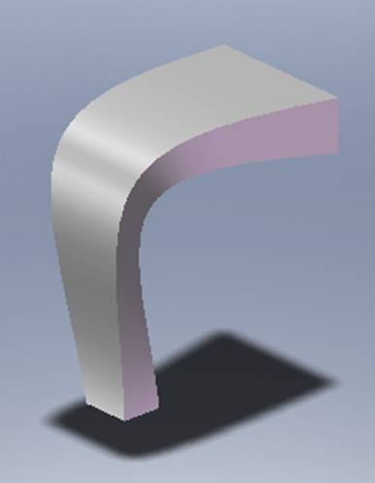
Loft Command in SW
Loft using a single Guide Curve.
Profile
Guide, 3D sketch
Profile

Slide 15
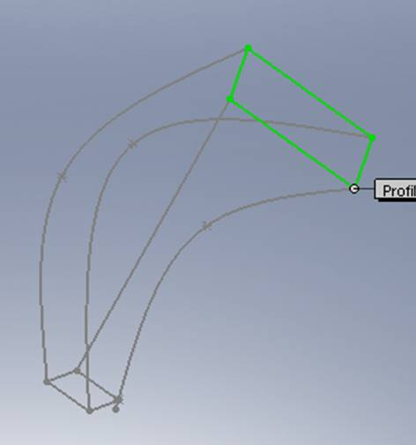
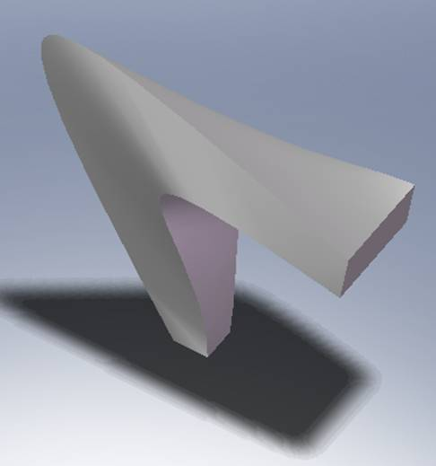
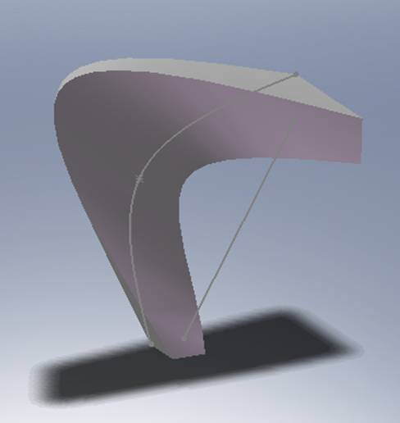
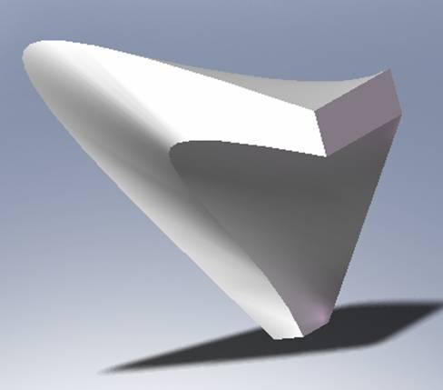
Loft Command in SW
Loft using 4 Guide Curves.
Guide 3
Guides 1,2,3
Guide 4
Guide 2
Guide 1
Guides 1,2
Guides 1,2,3,4

Slide 16
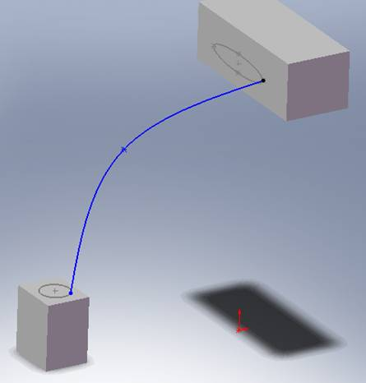
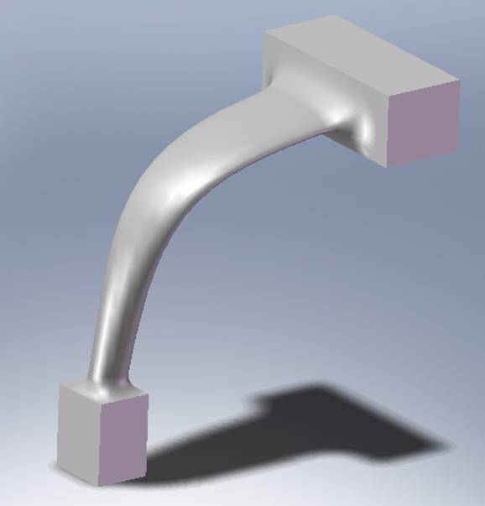
Loft Command in SW
Merging a Loft with a feature

Slide 17
Clicker Question 1
For the Loft command to work, which statement is true?
One profile and one path curve (guide) is required
B) One profile and two path curves (guide) are required
C) At least two profiles
D) Multiple profiles and guide curves could be used
E) C and D

Slide 18
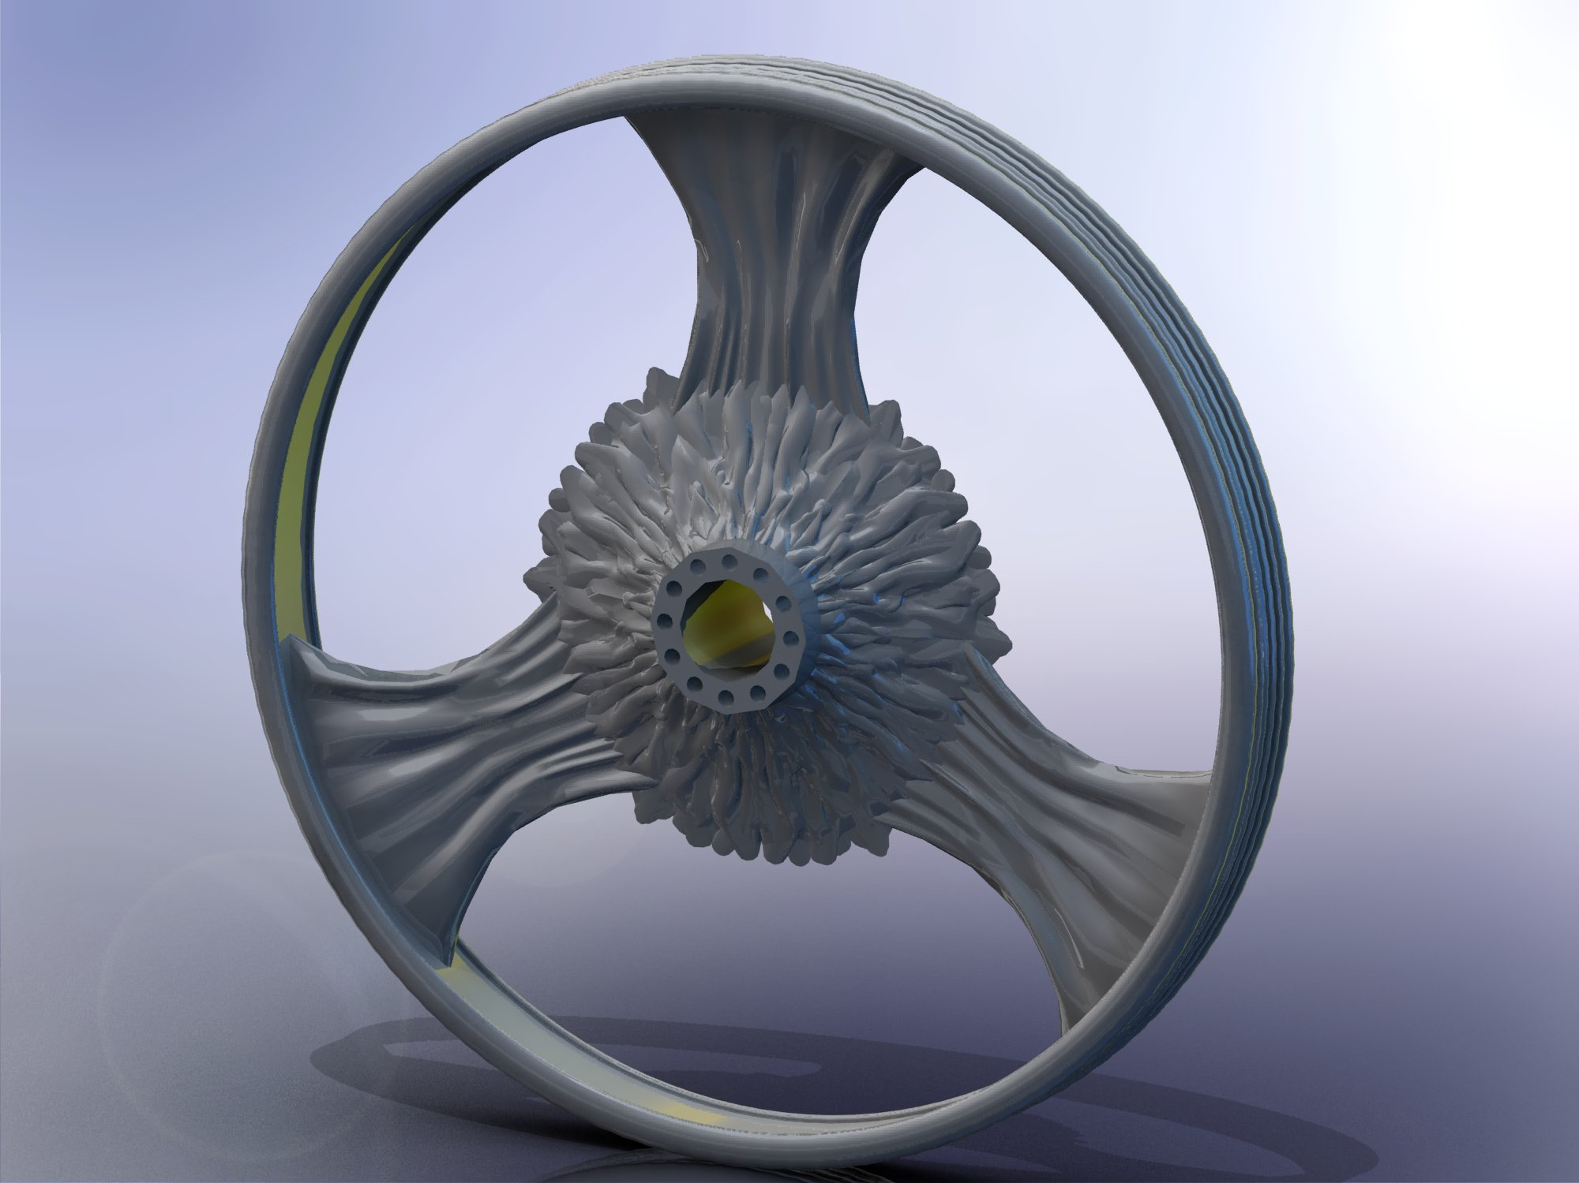

Slide 19
10 spline sketches on 10 planes .3 inches apart

Slide 20
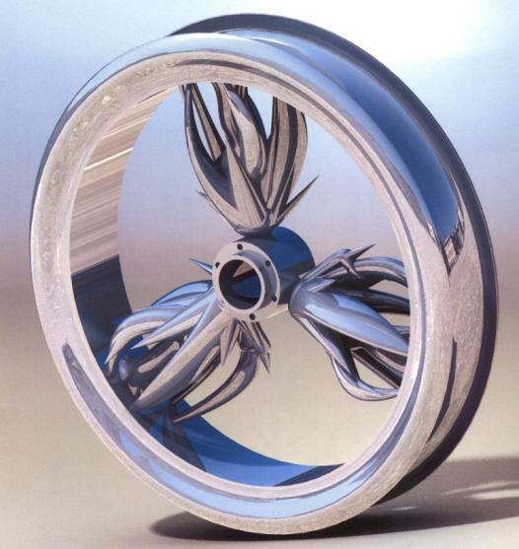

Slide 21
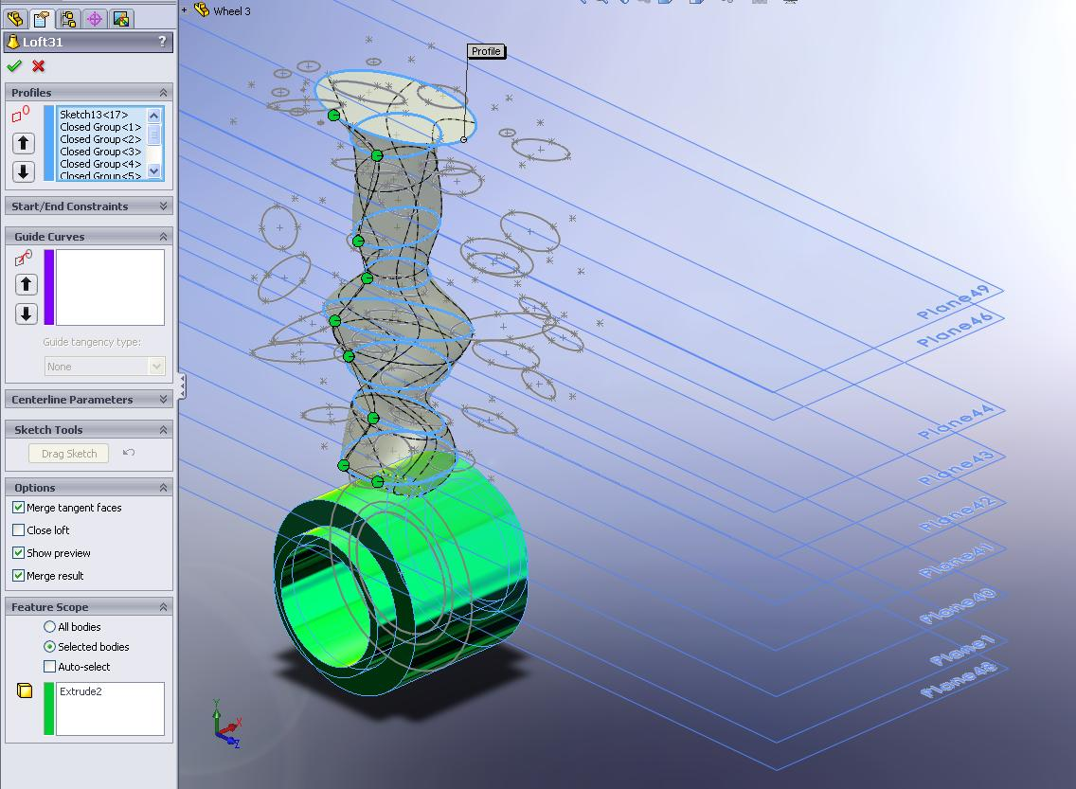
Example

Slide 22
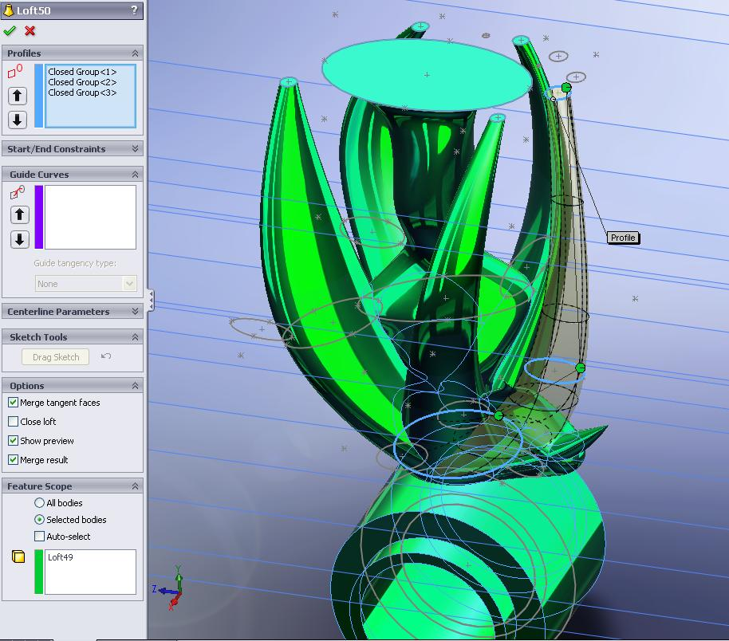

Slide 23
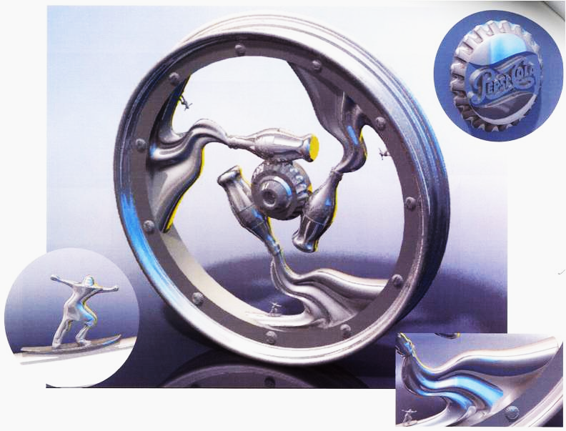

Slide 24
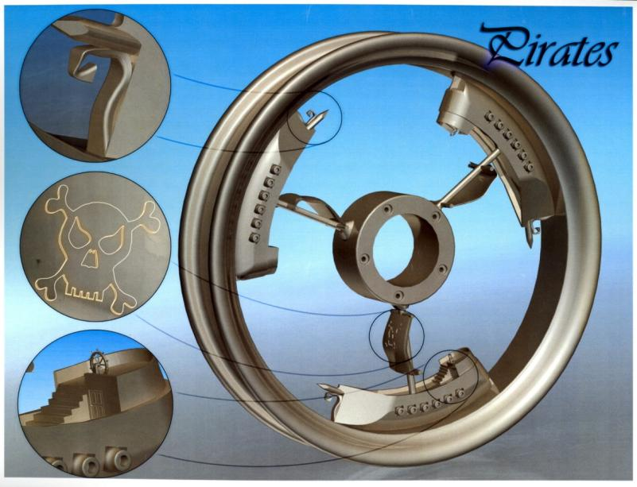

Slide 25
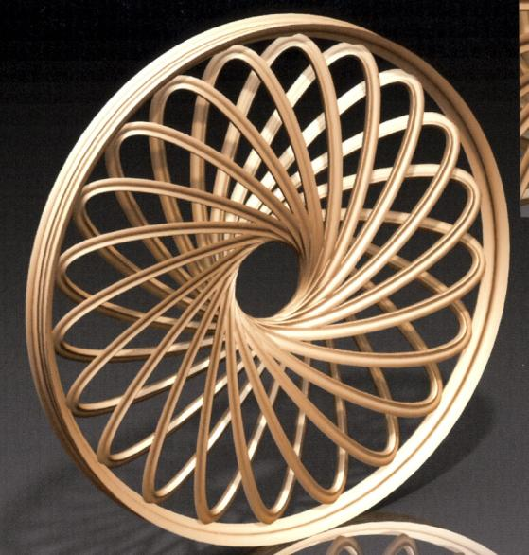

Slide 26
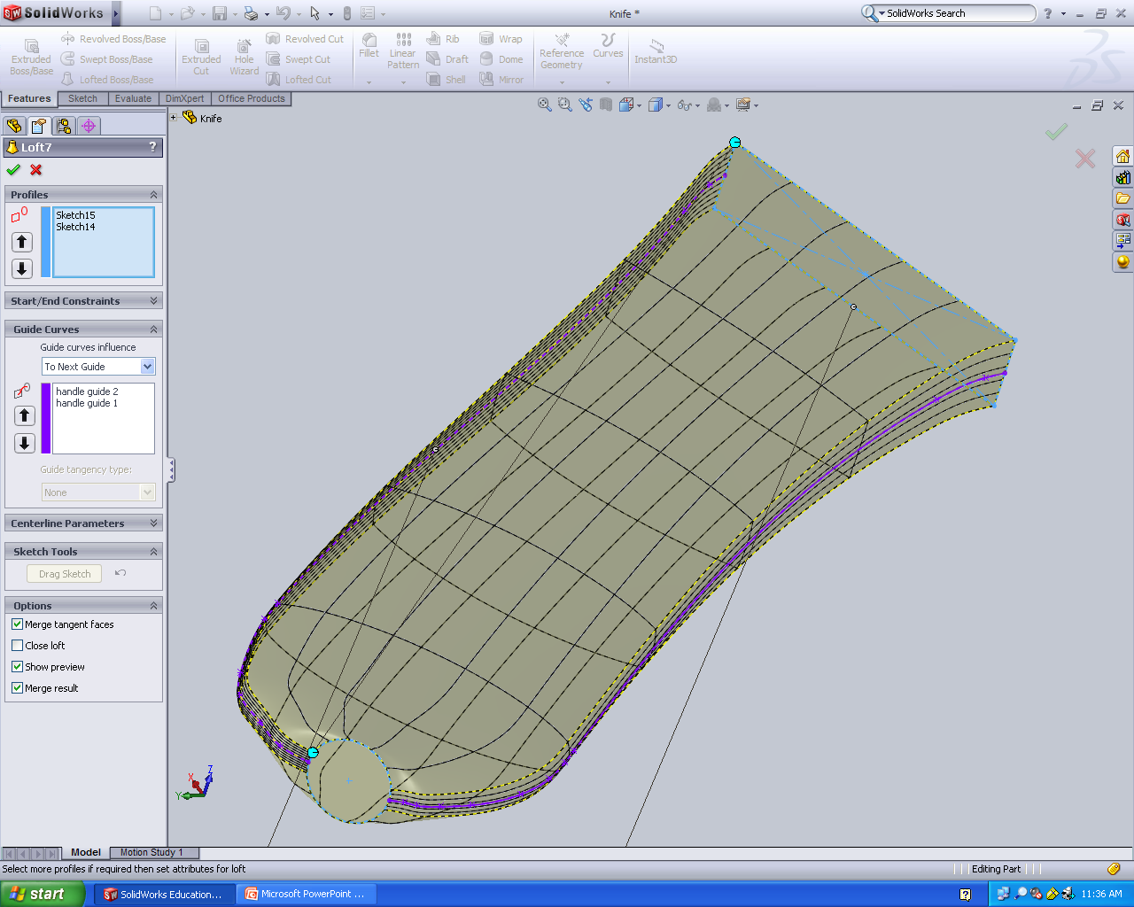
Knife handle

Slide 27
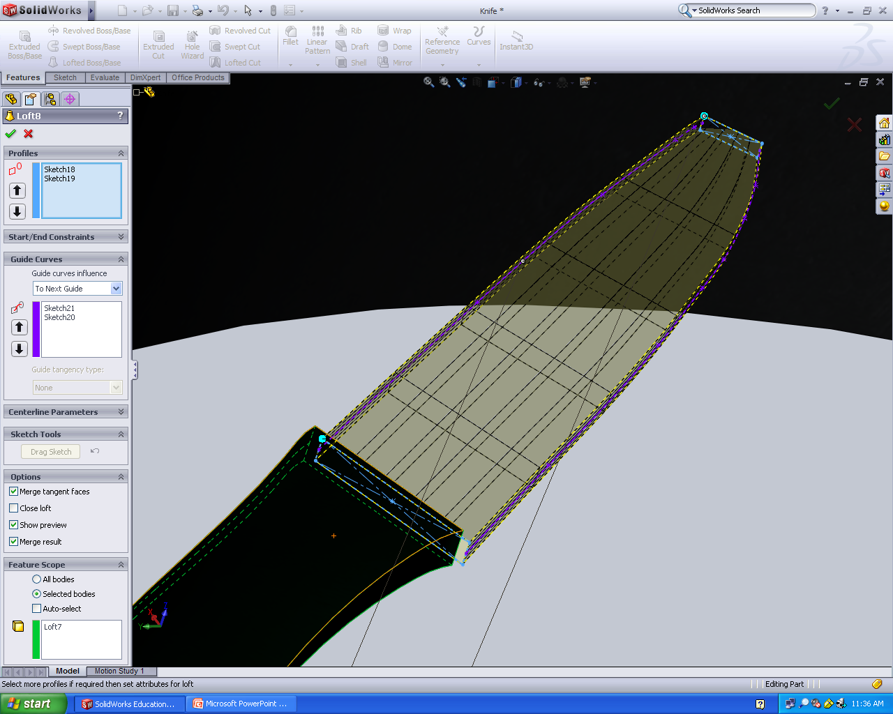
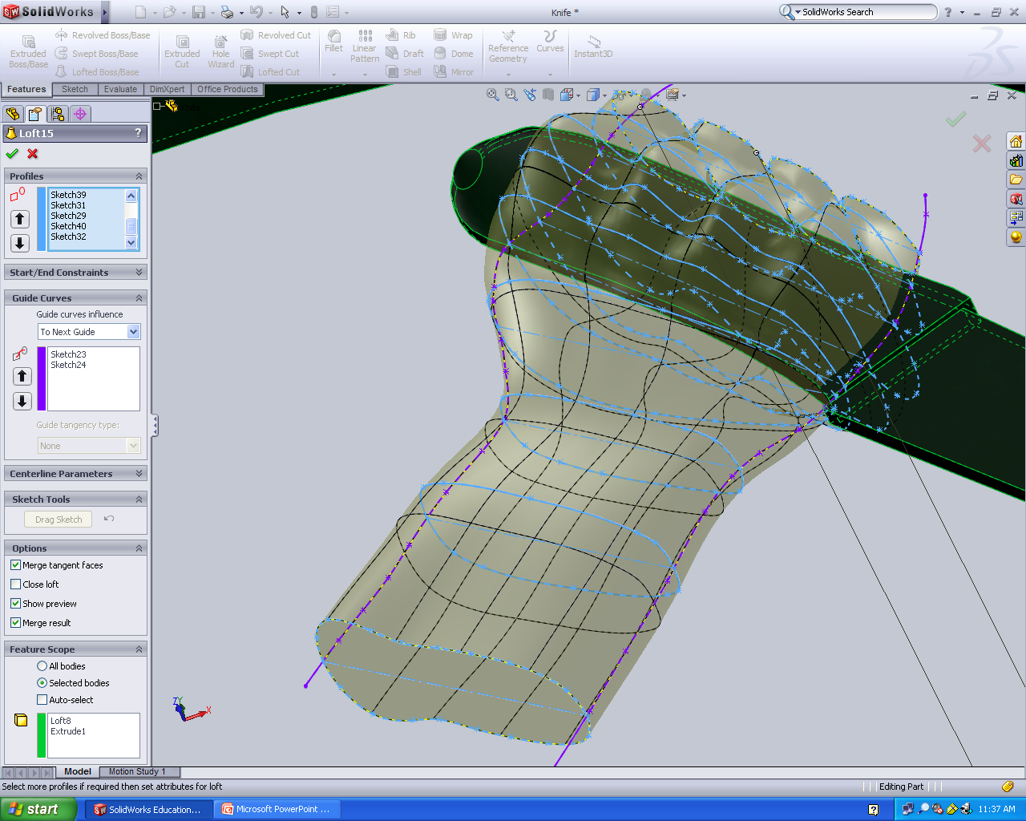
Knife blade
Hand and wrist

Slide 28
Clicker Question 2
Which of the following statement(s) is true?
Sweep requires one profile and two paths
B) Sweep requires one profile and one path
C) Loft requires at least two profiles and one path
D) Guide curves could be used in both Sweep and Loft
E) B, C and D

