Slide 1

Overview of Career Center Services by Kristin M Keller

Slide 2
Which resource does the SJSU Career Center provide?
FT / PT Job Search
Networking Tips
Resume/Cover Letter
Career Fairs / Events
Interviewing Practice
Explore Career Paths
Exploring Majors
LinkedIn Profile Review
All Of The Above
Notes:
SJSU Career Center offer all of these services

Slide 3

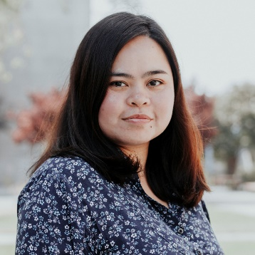





SJSU Career Center and You
We help students:
With career development during their time on-campus and beyond
Market your strengths to employers
Find opportunities to get real-world experience
That’s me!
Notes:
→ Market your traits to employers
resume building
interview preparation
job fair preparedness
Networking
→ Find opportunities to get real world experience
Job/Internship prep
Volunteer opportunities

Slide 4
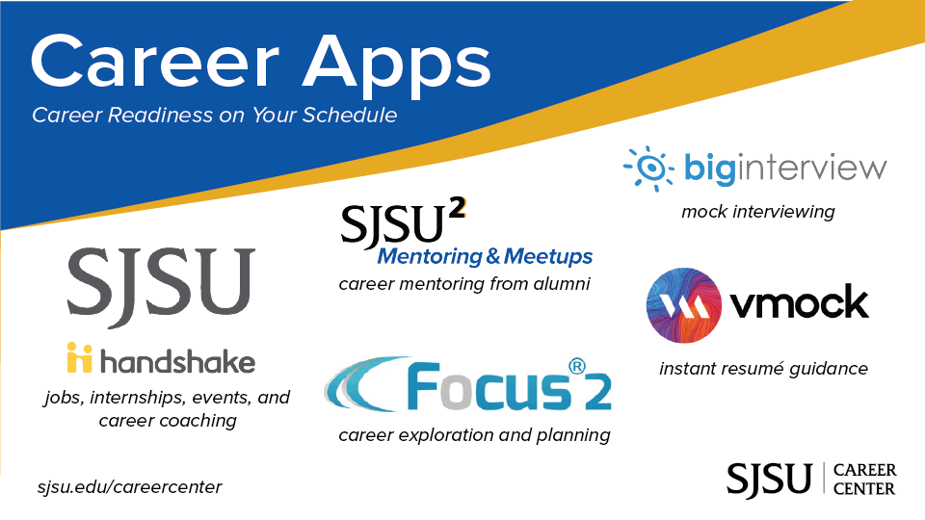
For more details visit sjsu.edu/careercenter > resources
Notes:
*OPTIONAL in the event that a live demo is not possible

Slide 5
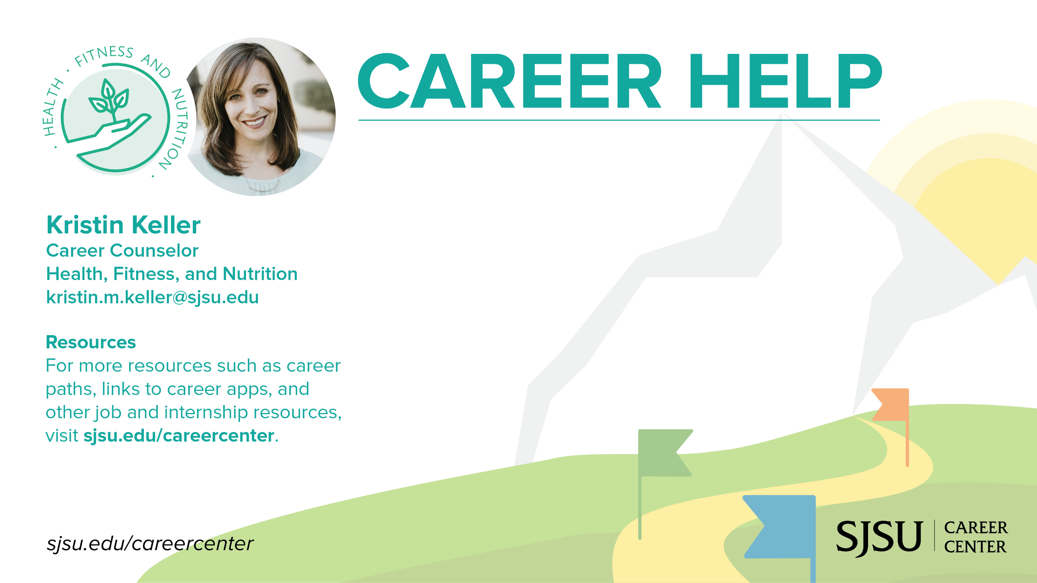
Schedule an appointment:
30 min 1:1 appointments available.
Book on Spartan Connect or email me directly.
Counseling Topics: Resume, Job Search, Networking, Interview Preparation and more!
Fall 2021: Virtual and In-Person Counseling offered M-F
Note: Next SJSU Health Job and Internship Fair offered in Spring 2022

Slide 6
Thank you!

