Slide 1


Expanding Accessibility in Higher Education: Engaging all Students for Success
Elizabeth Tu,
Andrea Golloher and
Matthew Love
San José State University
August 7, 2019
The 5th Annual CAST UDL Symposium

Slide 2
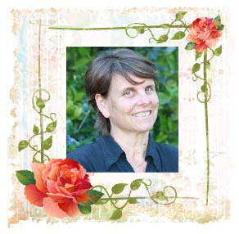
In Memory of Dr. Amy Strage
Thanks for sponsoring and supporting this Inclusive UDL Faculty Ambassadors program…
To the Presentation

Slide 3
Session Overview-Table of Contents
Our Context
Our Campus vs National data
Our Efforts to Date
Our Findings
Take-aways
Points of Contact
Download the Slides

Slide 4

Meeting the Demands of a Large Campus
Campus:
  1 of 23 campuses in the California State University system
  Urban setting
  Very diverse student population (race, ethnicity, academic preparations, educational and career aspirations, etc..)
Students:
  Total enrollment: ~ 35,400 (Fall 2018)
  Beginning: as Frosh ~35%; as Transfer students ~65%
  Registered w/ Accessible Education Center: ~ 1300 (3.67%)
Faculty:
  Full-time & part-time: ~ 1600 - 1700
  Average load for full-time faculty: 4 courses/semester
SJSU Campus Context

Slide 5
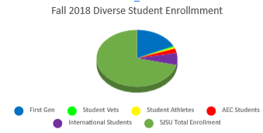
SJSU Campus Context…
According to SJSU Fall 2018 ethnicity statistics, our students include Asian (40.4%), Latinx (27.1%), White (19%), Two or more (4.5%), Not specified (5.2%), Black (3.2%), Pacific Islanders (0.4%), native Americans (0.1%) ethnic background.
First generation 8931 (25.23%), student vets 297 (0.84%), student athletes 446 (1.26%), and international students 3396 (9.6%).
Approximately 1300 (3.67%) students have registered with AEC to request for support .
Campus Partners

Slide 6
Our Partners
To ensure we are in compliance, Accessible Technology Initiative Instructional Materials (ATI IM) committee partners are working together on campus
  3 College Associate Deans
  2 Faculty Representatives
  Academic Senate and Department Chair Representative
  Accessible Education Center
  Center for Faculty Development
  eCampus
  IT
  Student
  University Library
  Academic Affairs Administrator
  The Bookstore
23 CSU campuses meet and share experiences at monthly ATI IM webinar meetings
  CSU ATI at the Office of the Chancellor
  23 CSU ATI IM Communities of Practice
ATI Hierarchy

Slide 7
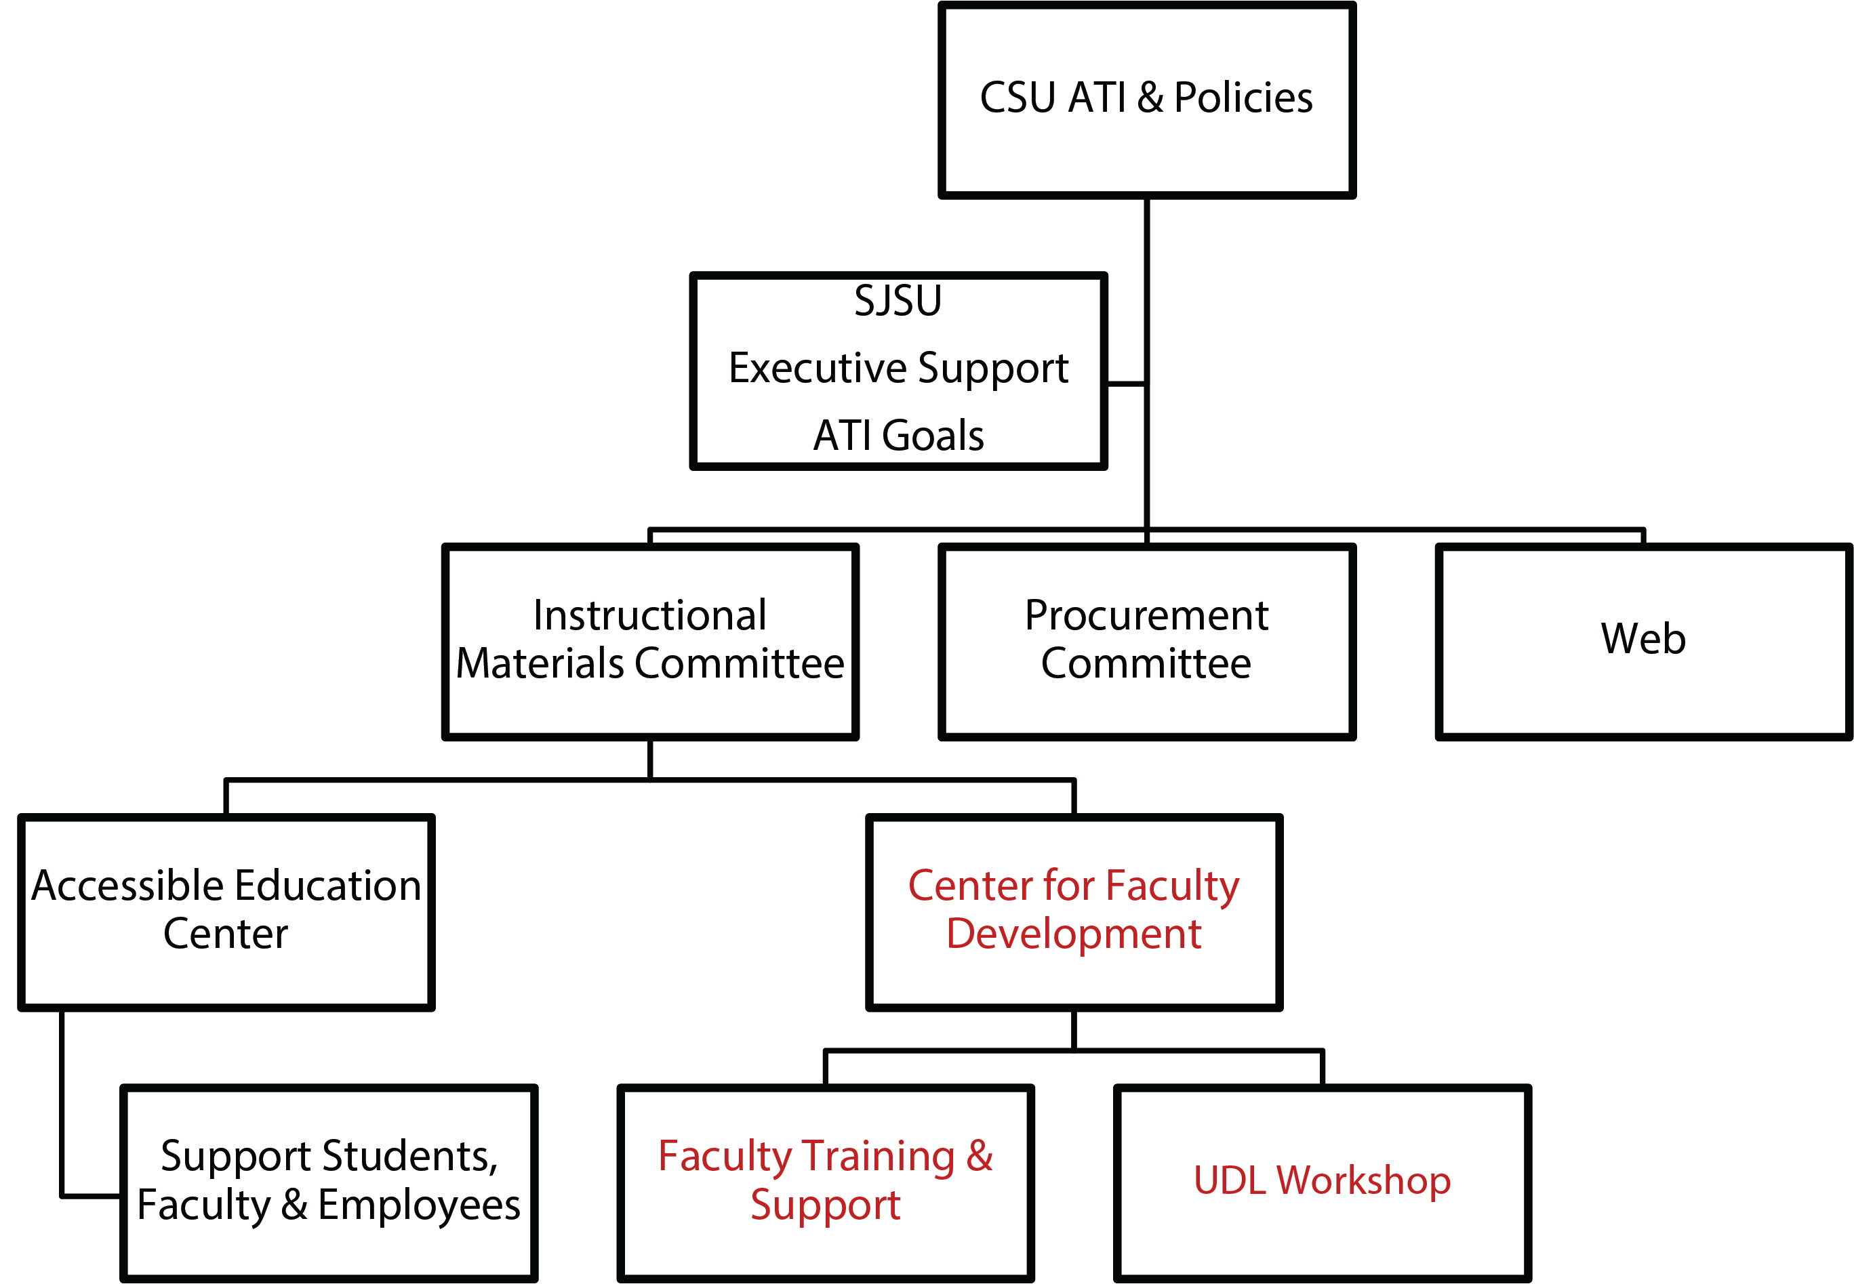
Our ATI Hierarchy
National Disability Data

Slide 8
National Disability Demographic Information
According to the US Census Bureau report, about 56.7 million people — 19 percent of the population — had a disability in 2010
The percentage of undergraduates who reported having a disability was 19.4 percent in 2015-16.
26 percent of undergraduates who were veterans reported having a disability…
~ Fast Facts from National Center for Education Statistics
Trends and Issues

Slide 9
SJSU AEC Students Registration…
Students registered with Accessible Education Center (AEC)
An increase from 3% in Fall 2005 to 3.67% in Fall 2018
Semester | AEC Registered Students | SJSU Student Enrollment
Fall 2005 | 890 (3%) | 29,975
Fall 2006 | 933 (3%) | 29,604
Fall 2007 | 1073 (3%) | 31,906
Fall 2008 | 1124 (3%) | 32,746
Fall 2009 | 1127 (3.6%) | 31,280
Fall 2010 | 1058 (3.6%) | 29,076
Fall 2011 | 1127 (3.7%) | 30,236
Spring 2012 | 1102 (3.9%) | 28,002
Spring 2013 | 1125 (4.1%) | 27,503
Spring 2015 | 1142 (3.8%) | 29,954
Spring 2016 | 1069 (3.6%) | 29,594
Spring 2017 | 1096 (3.75%) | 29,200
Fall 2018 | 1300 (3.67%) | 35,400
Trends and Issues

Slide 10
Student Disclosure Issue
…a gap between the reported national disability statistics comparing to SJSU campus statistics
  19.4% of undergraduates nationally vs. 3.67% at SJSU
  26% of student vets nationally vs. 0.84% at SJSU
Only about 35% of students choose to disclose their disability in college…
  Getzel (2014)
  Wagner, Newman, Cameto, Garza, , &
  Levine (2005)
  Newman & Madaus (2014)
Insights
  Getzel (2014)
  Wagner, Newman, Cameto, Garza, , &
  Levine (2005)
  Newman & Madaus (2014)

Slide 11
Why Do So Many Student Not Receive Support?
Registration is voluntary:
  Different landscape than K-12. Many students opt to not “disclose.”
Students have never had supports before:
  Their needs are “new”, and/or were not recognized before.
They have difficulties accessing the services available to them:
  Locating the relevant units; completing assessments; following through in a timely way.
They prefer to eschew the process and forego the supports.
  They find the process of disclosing to each faculty member & in each class humiliating and stigmatizing
  They deny needing support
  They avoid the responsibility of managing accommodations
  They want to turn over a new leaf – see if they can do without
SJSU Disability Data

Slide 12
SJSU AEC Student Distribution
Type of disabilities registered at AEC in Fall 2018
ADD/ADHD = 15%
Asperger’s Syndrome = 9 %
Blind &Visually Impaired = 1%
Communication = 1%
DHOH = 3%
Learning disability = 28%
Medical/Physical = 13%
Mental Health = 28%
Mobility = 2%
Total = ~1300 (February, 2019)
Data Summary

Slide 13
In a Nutshell...
It is likely that somewhere between 10-20% of college students would qualify for – and benefit from – accommodations suited to their learning needs. Yet typically, most campuses report that 3-4% of their students are registered to receive such supports.
Faculty are more open to providing additional supports for students with “visible” disabilities than to students with “invisible” disabilities.
Faculty are generally unaware of – but can readily learn and come to implement – relatively simple practices and adjustments that can make a significant difference (e.g., UDL).
Faculty Training Program

Slide 14
Inclusive Teaching Program
30 faculty members participated in a three-half day Inclusive Teaching workshop in Summer 2018
25 implemented their re-designed plan, submitted accessible syllabus and course materials, shared their experiences and completed the program in the subsequent semester.
Workshop Activities

Slide 15
Workshop Activities
Select a student profile and be mindful of their needs and the issues of non-disclosure and invisible special student learning needs to design a course activity to address these issues.
Adopt UDL principle(s) and guidelines in their redesigned course activity.
Identify at least one campus resources (OER materials, campus instructional technologies, and various books on pedagogy) and indicate how they may draw upon such resources.
Apply accessibility guidelines in the creation of text course documents and non-text multimedia course materials.
Implement the re-designed course materials and/or activities based on accessibility guidelines and UDL principles through the use of appropriate campus resources suited to their selected students profile with special needs, and share their experiences or lessons learned at the end of the subsequent semester.
Workshop Flowchart

Slide 16
Workshop Flowchart
Below is our workshop activities in a flowchart format.
Student profile/needs identified?
UDL Principle(s) adopted?
Teaching pedagogy (OER materials, technology, course activity) identified?
Accessibility guidelines followed?
Implementation experience and lessons learned shared?
Impact of this Project

Slide 17
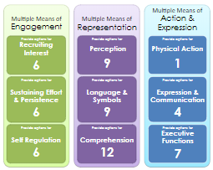
Impact
All faculty reported plans to update their courses using the UDL framework. When asked to identify specific checkpoints they planned to address, most faculty indicated they would address issues related to Representation.
Below is a table of faculty self-report of UDL checkpoints they would address when updating their courses.
Representation

Slide 18
Faculty’s Adoption of Multiple Means of Representation
1.1, 3.1, 3.2, 3.3: Concept maps, course road map, & hands-on activities allow students to visually depict their understanding, critical thinking and planning… to make connections between the past, current content and how to organize difficult terminology within a chapter…
1.1, 1.2, 1.3, 3.1, 3.2: Morphology or making new words using audio, visual and kinesthetic styles
1.2: Captioning offers alternative for auditory info + Follow videos better when they are captioned correctly
2.2: Structure the doc for easy access to the specific topic
3.2: Use linguistic “think-aloud” to highlight the patterns, critical features, ideas and relationship on their concept cards
Shorten & simply slide shows, Canvas modules, left sidebars, add text headers for sections/modules
1.x, 2.x, 3.x: Cooperative learning small group work by using Microteaching in teaching logical fallacies – students are more responsible and strategic in their own learning
Learn visually & culturally by visiting museums rather than reading/attending class
Expression

Slide 19
Faculty’s Adoption of Multiple Means of Action & Expression
6.3: Provide note-taking study strategy by using index cards
4.1 & 5.1: Use iClicker, lab activity, and group discussion to engage student communication/responses and foster collaboration and community
6.0 – 6.4: Use visual template and checklist/visual map to complement oral description, draw students out to set their goals, manage their learning, and monitor their own progress
6.2: Pay more attention to unique student characteristics to be in accord with UDL principles…students taking more responsibility and becoming more strategic in their own learning
5.2: Use multiple tools for construction and composition by providing sentence starters or sentence strips
Engagement

Slide 20
Faculty’s Adoption of Multiple Means of Engagement
7.2: Use Service Learning experience to optimize relevance, callus and authenticity
9.0 – 9.3: Students retain materials better, improve performance on exams, show more confidence in reciting and doing boardwalk when introduce to the morphology and learning Latin and Greek roots
7.3 & 8.3: Begin every class with a 5-minute mindful meditation to minimize threats & distractions. Foster collaboration and community by setting group roles (facilitator, recorder, timekeeper) offer decision making techniques (authority, majority, consensus, compromise) and team rotation.
7.0 & 8.0: Use collaborate approach to have student read a chapter, report to the others in the group and teach each other. Presented "Virtual & Tele-operated Robots for Robotics Education" at the CSU Lab Innovation with Technology (LIT) program. Students use video lectures to prepare for their finals and perform lab experiments better with the procedure, programming, expected robot motion, etc. than via animated-based operation in robot control.
8.0: Sustain student effort by including a short reflection at the end of each session, rotating roles each day, and using Google Docs.
7.0: Design in-person and online discussion so that they are authentic, communicate to real audiences (e.g. US President), and reflect a purpose that is clear to the participants
Take-aways

Slide 21
Take-aways
Faculty: Think and design courses inclusively by adopting UDL Guidelines with hands-on opportunities to engage academic success for ALL students
Campus partners: Join to support faculty in designing inclusive teaching
Faculty Professional Development: Offer this Inclusive Teaching program annually to create campus Immersion UDL Faculty Ambassadors

Slide 22
Questions?
Elizabeth Tu
Instructional Designer & Accessibility Consultant
Center for Faculty Development
  Elizabeth.Tu@sjsu.edu
  Phone: 408.924.3093
Andrea Golloher, Assistant Professor
Department of Special Education
  Andrea.Golloher@sjsu.edu
  Phone: 408.924.5791
Matthew Love, Assistant Professor
Department of Special Education
  Matthew.Love@sjsu.edu
  Phone: 408.924.3695
  Thank You!

Slide 23
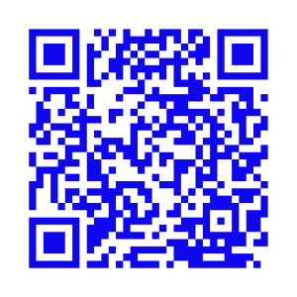
Download the Slides
  SJSU Accessibility Instructional Materials page
  http://www.sjsu.edu/accessibility/instructional-materials/

